Slide 1
SERVICE INNOVATION
NORSI
April, 2013

Slide 2
Content of my part
General introduction to service innovation issues
Service innovation approaches and challenges
Service innovation as innovation in service industries and as servitization
Service innovation and innovation systems
Service innovation management
Open innovation in service(s)
From services to service – towards a service dominant logic

Slide 3
Purpose
Give an overview of research issues of relevance to service innovation through examples of how research is conducted in the area
Give a deeper understanding of a selected set of research issues in service innovation, including approaches, service innovation definitions, methodologies, service characteristics, productivity, innovation systems, firm level service innovation management, open service innovation and service systems

Slide 4
1. General introduction to service innovation – the traditional perspective
Services – definitions, characteristics and perspectives
Service innovation – challenges and characteristics
Innovation management in service(s)

Slide 5

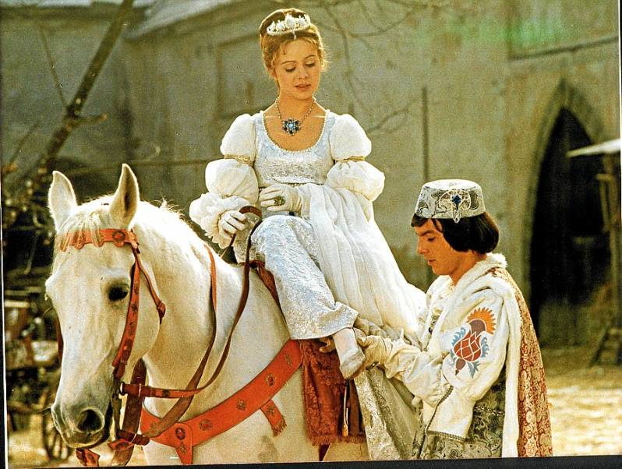
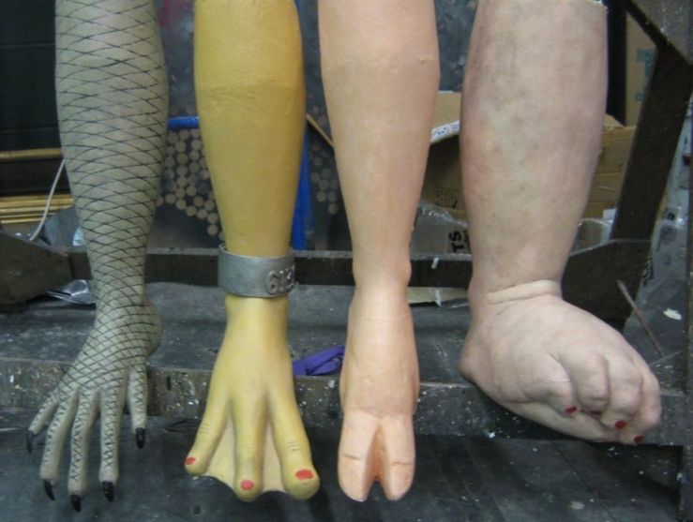
1. Background and recent interest
Fundamentals
  Service industries represent about 60-70% of gross domestic product and 70-80% of employment in most western countries/economies
  In addition, services in manufacturing industries should be added
  Service industries receive only about 30% of financial government support of innovation… why is that?
Potential
  Demand for services grows faster that the demand for manufactured goods
  Productivity growth in European service industries is low. In US almost all productivity growth can be explained by the productivity growth in the service sector
  KIBS among the most innovative industries of all (self reported)
  In open programs, service innovation projects represent app. 50% of projects (not funding)

Slide 6
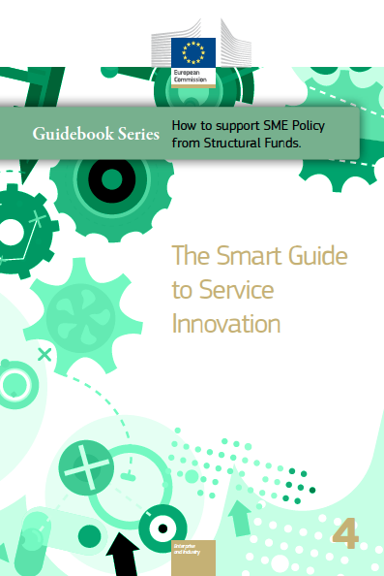
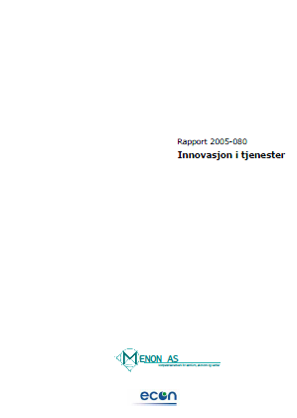

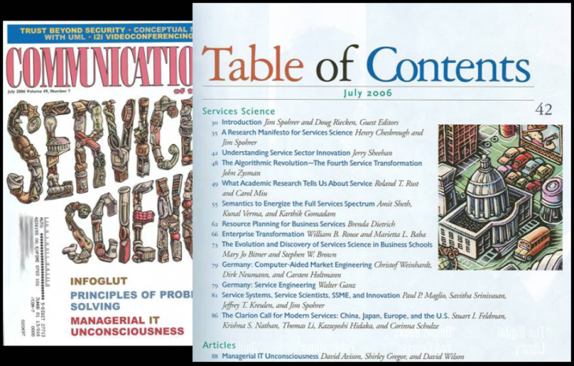

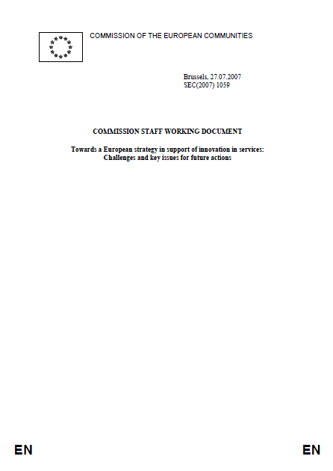


Recent interest in these issues…

Slide 7
Services and service – different meanings
Service and services – definitions:
  Economics … A service is the intangible equivalent of an economic good. Service provision is often an economic activity where the buyer does not generally, except by exclusive contract, obtain exclusive ownership of the thing purchased.
  Grønroos (1990): A service is an activity or a series of activities of a more or less intangible nature that normally, but not necessarily, take place in interaction between the customer and service employees and/or physical resources or goods and/or systems of the services provider, which are provided as solutions to customer problems.
Service and services- services first:
  Services as service industries – the traditional meaning focused in service marketing and in service studies in the 90’s
  Services as knowledge intensive services – the late-90’s interpretation of “important” service providers focused in the KIBS and KISA literature
  Services as value added services – the interpretation of services as value added services and service encapsulation used in studies of manufacturing industries. Renewed interest in 20’s

Slide 8
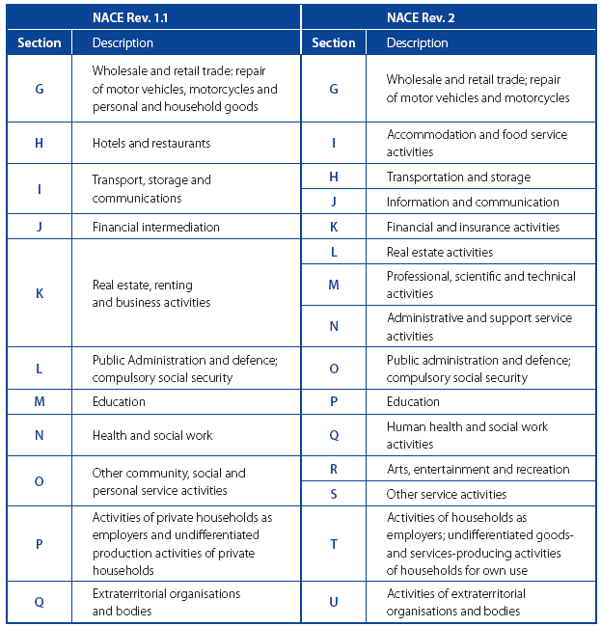
Services as service industries 1

Slide 9
Services as service industries 2
Service industries are represented by all industries with NACE-codes above 45 (Norway), that is ”wholesale trade and up”…
  Consumer services: Services to domestic consumers (banking, insurance, travel and tourism, leisure, telecommunications, etc…)
  Industrial services: Services to business customers (including some of the above if serving both segments, but also business services)
  Business services: Services provided by specialized firms to other firms (e.g. accounting, legal, design, maintenance, personnell)
  Market vs. non-market services:
  Services produced for sale on the
  market at a price vs. provided to
  the community as a whole free of
  charge
  Public services: services provided
  by government to its citizens,
  either directly (through the public
  sector) or by financing private
  provision of services

Slide 10
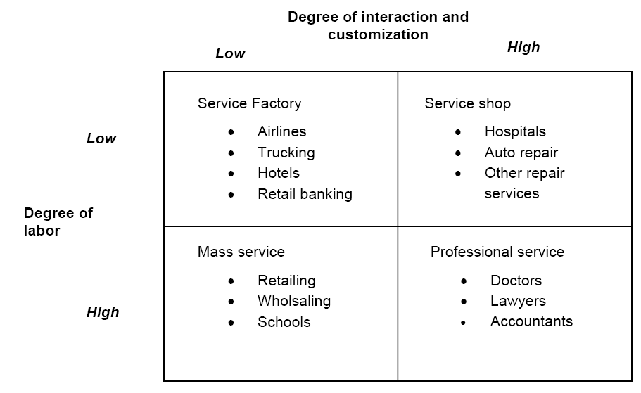
Categorizing services in research 1 – service characteristics (Schmenner, 1986)

Slide 11
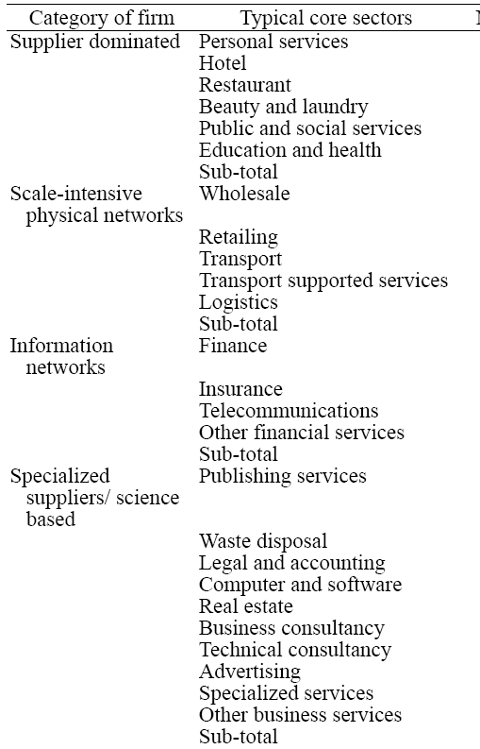
Categorizing services in research 2 – service industry characteristics
Soete and Miozzo (from Pavitt, 2001):
  Supplier dominated (e.g. public
  and personal services)
  Scale intensive physical networks
  (e.g. transport)
  Network services (e.g. telecoms
  and banks)
  Specialized services (e.g. KIBS)
In a study in 2005, Pedersen and
Nysveen (2005) identified at least
40 different industry classifications
applied in services

Slide 12
Think – Example, when does an industry become a service industry?
J - Information and communication
J58 - Publishing activities
J58.1 - Publishing of books, periodicals and other publishing activities
J58.1.1 - Book publishing
J58.1.2 - Publishing of directories and mailing lists
J58.1.3 - Publishing of newspapers
J58.1.4 - Publishing of journals and periodicals
J58.1.9 - Other publishing activities
J58.2 - Software publishing
J58.2.1 - Publishing of computer games
J58.2.9 - Other software publishing
J59 - Motion picture, video and television programme production, sound recording and music publishing activities
J59.1 - Motion picture, video and television programme activities
J59.1.1 - Motion picture, video and television programme production activities
J59.1.2 - Motion picture, video and television programme post-production activities
J59.1.3 - Motion picture, video and television programme distribution activities
J59.1.4 - Motion picture projection activities
J59.2 - Sound recording and music publishing activities
J59.2.0 - Sound recording and music publishing activities
J60 - Programming and broadcasting activities
J60.1 - Radio broadcasting
J60.1.0 - Radio broadcasting
J60.2 - Television programming and broadcasting activities
J60.2.0 - Television programming and broadcasting activities
J61 - Telecommunications
J61.1 - Wired telecommunications activities
J61.1.0 - Wired telecommunications activities
J61.2 - Wireless telecommunications activities
J61.2.0 - Wireless telecommunications activities
J61.3 - Satellite telecommunications activities
J61.3.0 - Satellite telecommunications activities
J61.9 - Other telecommunications activities
J61.9.0 - Other telecommunications activities
J62 - Computer programming, consultancy and related activities
J62.0 - Computer programming, consultancy and related activities
J62.0.1 - Computer programming activities
J62.0.2 - Computer consultancy activities
J62.0.3 - Computer facilities management activities
J62.0.9 - Other information technology and computer service activities
J63 - Information service activities
J63.1 - Data processing, hosting and related activities; web portals
J63.1.1 - Data processing, hosting and related activities
J63.1.2 - Web portals
J63.9 - Other information service activities
J63.9.1 - News agency activities
J63.9.9 - Other information service activities n.e.c.
In previous NACE
categories J58 was
part of C18 Printing
What about the other sectors that will be transformed by digitization? Will they also gradually be Information and communication services?
How about manufacturing sectors? Are they already, e.g. oil and gas?

Slide 13
The service innovation challenge- employment
Primary
Manufacturing
Services
Employment, share of persons employed
Source SSB

Slide 14
Gross domestic product
Primary
Manufacturing
Services
GDP (fixed proces mill NOK)
Source SSB

Slide 15
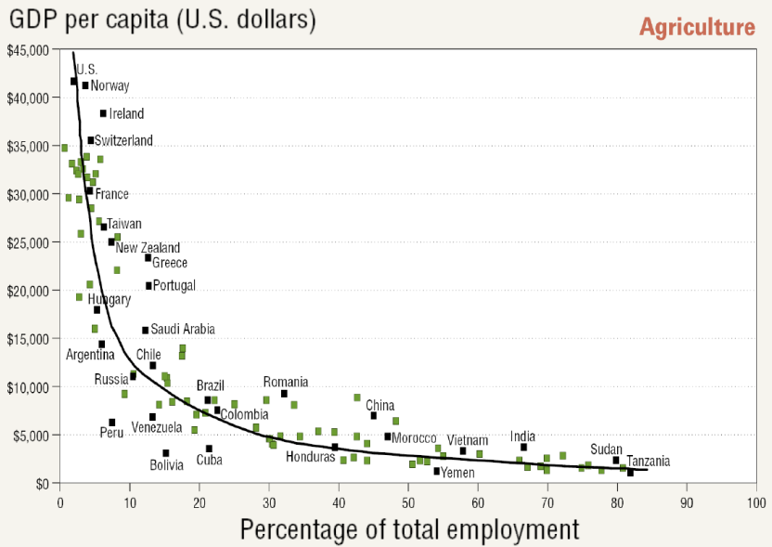
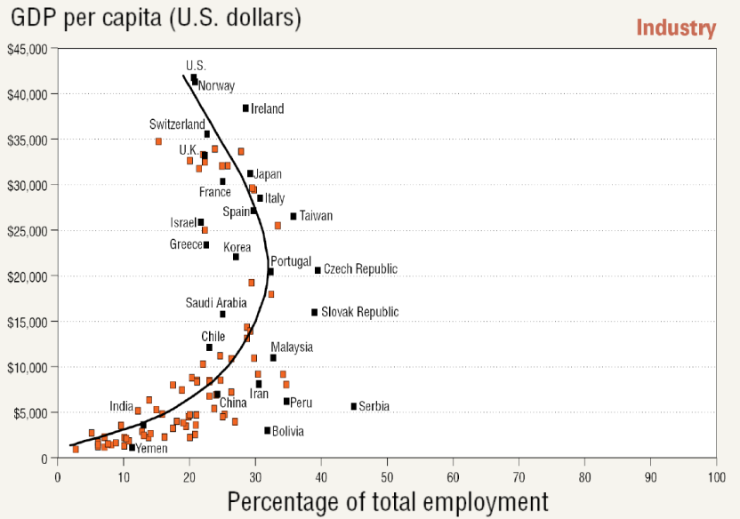
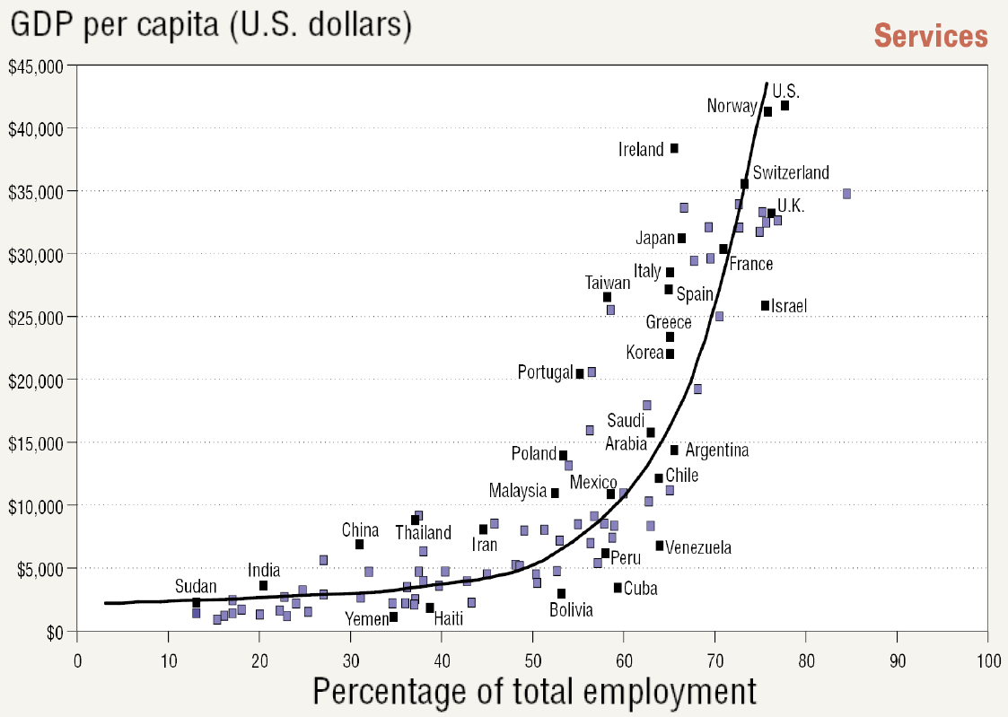
Countries (from Lush, 2012) – cause or effect?

Slide 16

Productivity in Norway
Baumol’s
disease
still relevant?
Primary
Manufacturing
Services
Accumulated change in GDP pr. hour (1970=100)
Source SSB

Slide 17
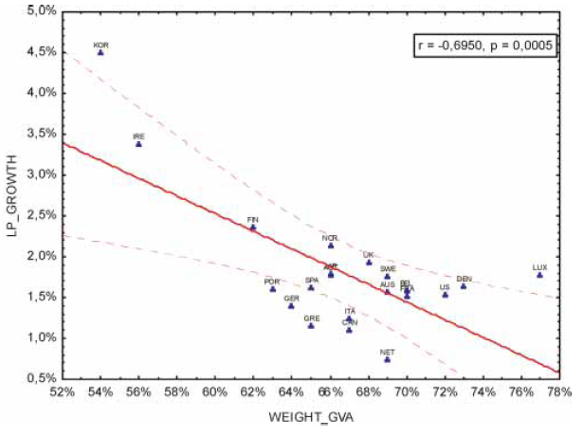
Maroto and Rubalcaba (2008)
Baumol: In some sectors work is the ends (required in the offering not to produce the offering), and demand in many such sectors is less affected by prices – increasing labour and low productivity growth
Productivity paradox: Low productivity growth despite investments in technology
Large differences between services, some contribute negatively (e.g. hotels, personal services, business services… ends and low technology…) to productivity growth, some positively (communications, financial, public … means and high technology….)
Large cross sectoral productivity effecs of services (e.g. outsourcing, business services)

Slide 18
Industries differ…..
Retail trade
Post and telecom
Financial services
KIBS
Manufacturing
Accumulated change in GDP pr. hour (1970=100)

Slide 19
Innovation costs …
Costs manufacturing
Public funding (man.)
Costs services
Public funding (serv)
Share of costs for and public funding of innovation (FoU/R&D, RDI)
Source SSB

Slide 20

Services as knowledge intensive services
KIBS – Knowledge intensive business services: Research in late 90’s suggested that some services where unique:
  With respect to growth
  With respect to their innovativeness
  With respect to their importance to innovation
  (in other sectors)
  These were termed KIBS - Wikipedia: knowledge-intensive support for the business processes of other organizations. T-KIBS, (those with high use of scientific and technological knowledge - R&D services, engineering services, computer services, etc.), and P-KIBS, who are more traditional professional services - legal, accountancy, and many management consultancy and marketing services.
  Aslesen and Isaksen (2007): it is a paradox that the large, supposed importance of KIBS does not show up more explicitly in quantitative innovation studies…
KISA – Knowledge intensive service activities

Slide 21
Industries differ…..
Retail trade
Post and telecom
Financial services
KIBS
Manufacturing
Accumulated change in GDP pr. hour (1970=100)

Slide 22



Services as knowledge intensive services 2
KISA – Knowledge intensive service activities
  Activities that can be carried out by external, specialized KIBS (Knowledge-Intensive Business Service firms) or in-house by employees of the firms using the KISA in question. They are all “knowledge-intensive” in terms of various indicators (Jones and Miles, 2008)
  Differences (Aslesen
  and Isaksen, 2007):
    Wider set of players
    Market and non-market
    exchange
    Co-production of knowledge
    (between provider and client)
  Seem to play a significant role in innovation, but difficult to manage due to a combination of internal and external knowledge sources and various forms of exchange (e.g. innovation policy)

Slide 23
Think – Outsourcing KISA in manufacturing
Examples:
  Accounting
  Personnel services /HR
  Payroll
  Cleaning services
  Property management and maintenance
  Customer support services
  IT services
Why are these services outsourced?
How does it affect firm level effectivity?
How does it affect productivity?

Slide 24
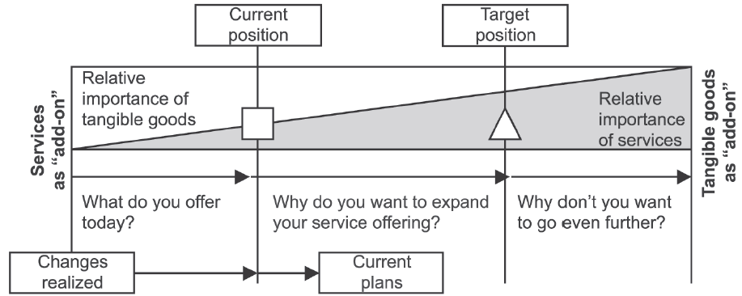
Servitization (Oliva and Kallenberg, 2003) and product-service systems (later)
A Product-Service System is an integrated product and service offering that delivers value in use (to be explained later).
Typical steps (for all goods producing firms):
  Consolidating product-related services (internal efficiency)
  Entering the installed base service market (define profit opportunity in services market itself)
  Expanding to relationship-based services (co-production of client services)
    or
  Expanding to process-centered services (consulting, cover al brands etc.)
  Taking over end-users operations (from paint producer to OEM paintline operations paid pr. car painted, Rolls-Royce’s “Power By The Hour”)

Slide 25

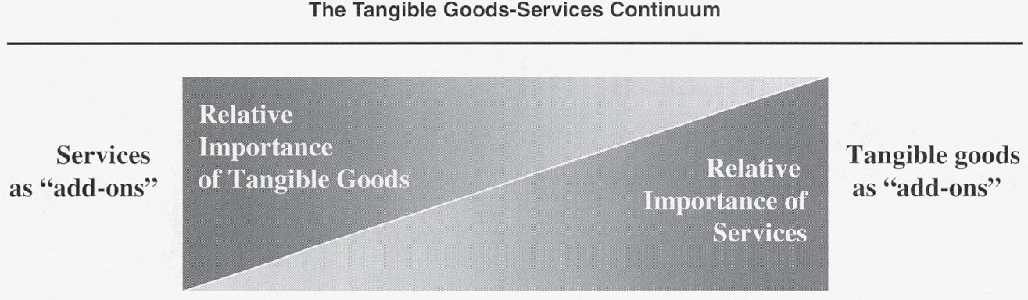
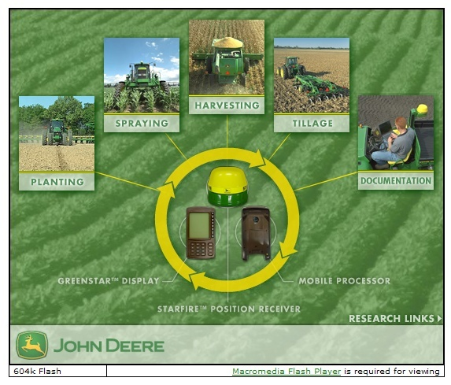
Services as value added services
Maintenance…. but….
GPS correction signal
Tractor software
JDOffice Agricultural Accounting
Stellar support education
John Deere Credit Company
John Deere Health
FoodOrigins (food tracking services)
Etc…

Slide 26






Service business models
Rolls-Royce’s “Power By The Hour”:
  Extensions:
  Mission Ready Management Solutions (MRMS ®)
  MissionCare™
  TotalCare®
  Etc…
From paint producer to
paint service provider
  Incentives to reduce
  spill and minimize use
  of dangerous chemicals
  Servicizing/servitization it is
  argued is a means
  to sustainability

Slide 27
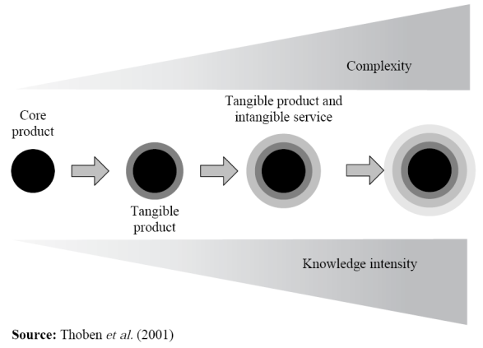
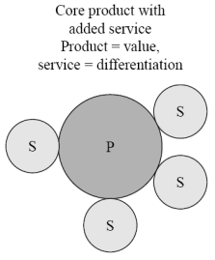



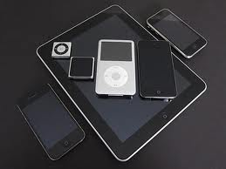
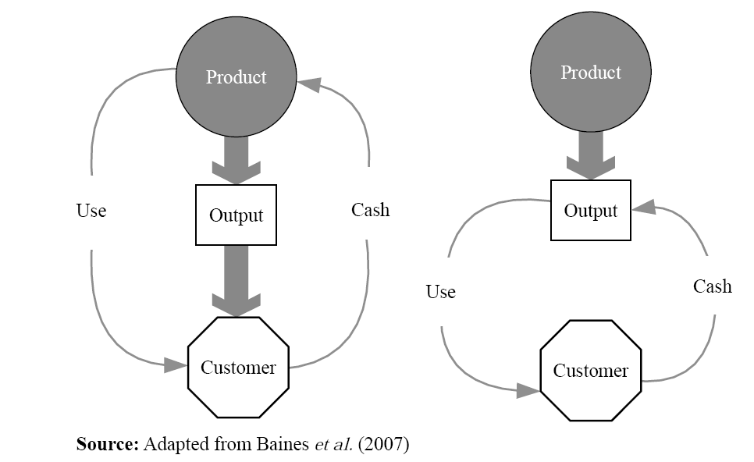
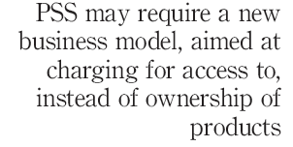
From value added services to service logic
Value added
services:
Service logic:
The product becomes
a platform for capturing
value from service
co-creation

Slide 28
Characteristics of services
Ref… definition in previous slides….
A service is the non-ownership equivalent of a good. Service provision has been defined as an economic activity that does not result in ownership and is claimed to be a process that creates benefits by facilitating either a change in customers, a change in their physical possessions, or a change in their intangible assets.
Typically characterized by the following (Zeithaml, Parasuraman and Berry, 1985):
  Intangibility
  Heterogeneity
  Inseparability
  Perishability
  The IHIP characteristics…

Slide 29
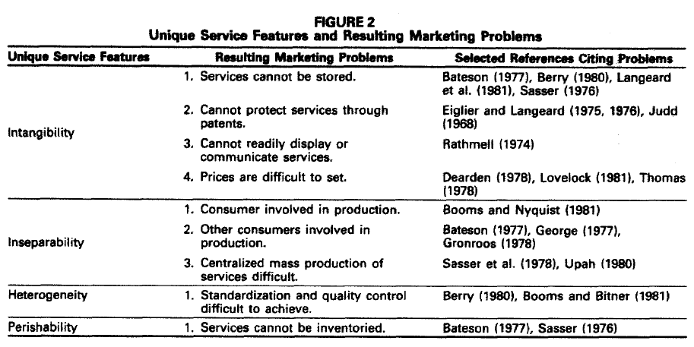

Slide 30
1. General introduction to service innovation – the traditional perspective
Services – definitions, characteristics and perspectives
Service innovation – challenges and characteristics
Innovation management in service(s)

Slide 31
2. Sercive innovation - Characteristics of services – implications for innovation
Service characteristics | Impact on organization of innovation process
Intangibility | Need for intensive communication between people involved in innovation, because new product cannot be felt or touched. Creating shared understanding is of highest importance
Simultaneous production and consumption | Close involvement of front and back office personnel is needed, largely due to simultaneous development of production process
Heterogeneity | No impact; physical products may also be heterogeneous
Perishability | No impact; new services can be developed in advance

Slide 32
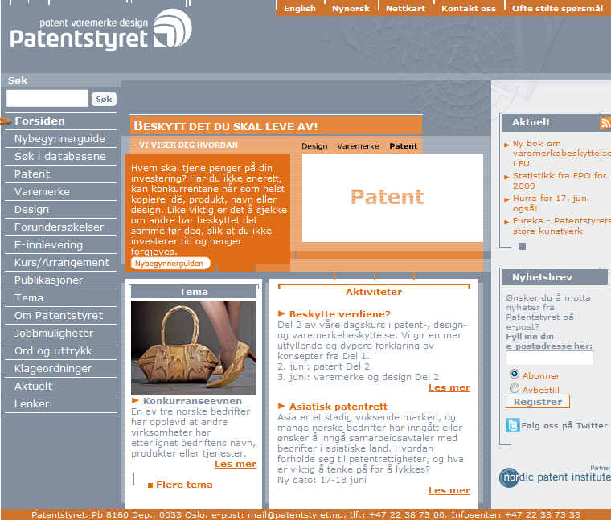
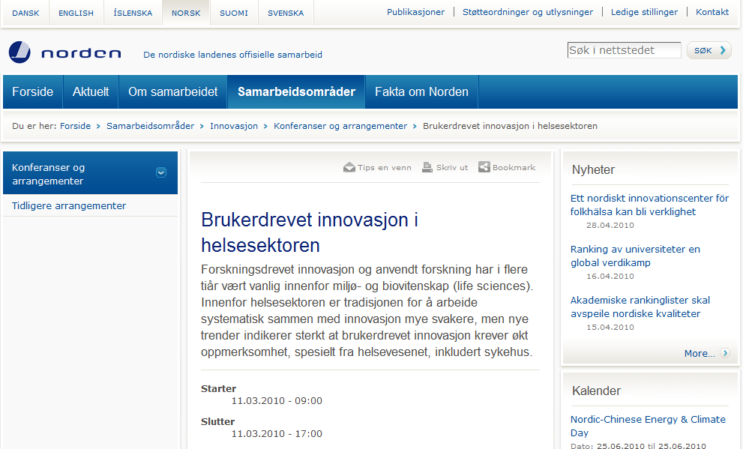


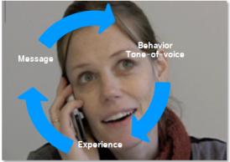
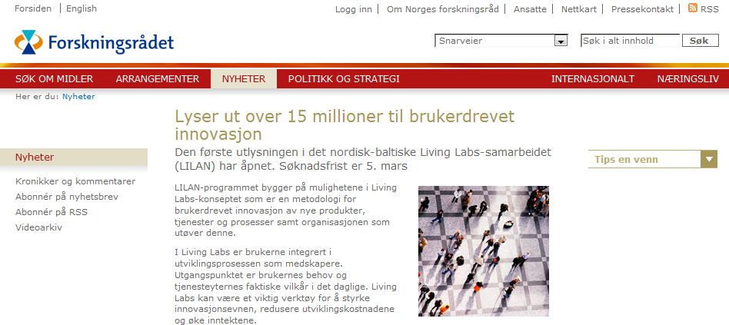



Challenges – service characteristics 1
Intangible – immaterial:
  Ex. Underinvestments in SI due to
  lack of protection (IPR)?
  Ex. Underinvestments in SI due to
  difficulties in describing and
  measuring effects?
Heterogeneity– customization:
  Ex. Underinvestment in SI that
  scales well because it conflicts
  with customization?
vs

Slide 33

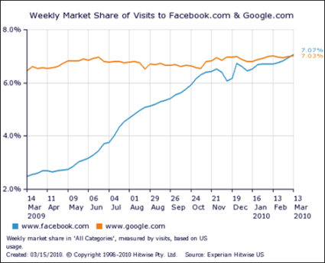

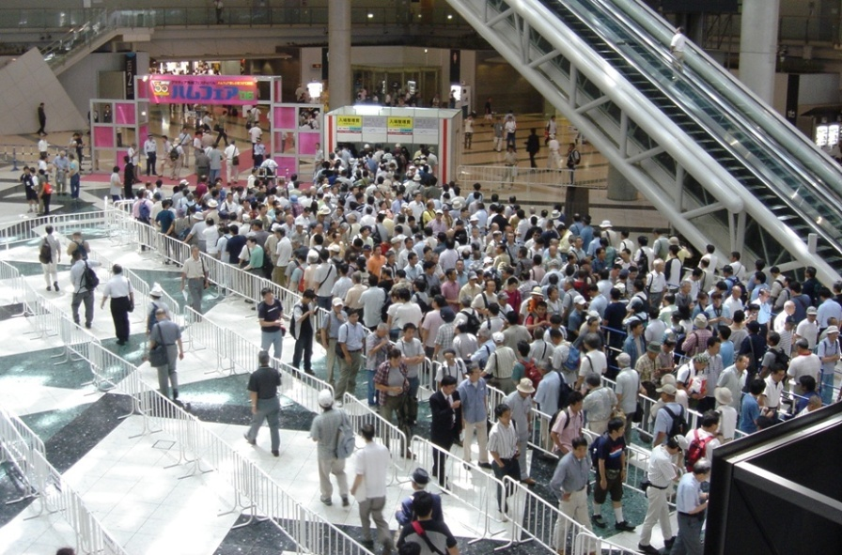
Challenges – service characteristics 2
Inseparable– co-produced/co-created with provider and customer:
  Ex. Are SI’s created by customers more than
  by providers?
  Ex. Is demand side economy of scale a
  precondition for successful SI?
Perishable– cannot be stored:
  Ex. Is it possible to apply
  traditional principles for
  product innovation to SI? Do their
  application lead to dysfunctional
  SI’s?

Slide 34
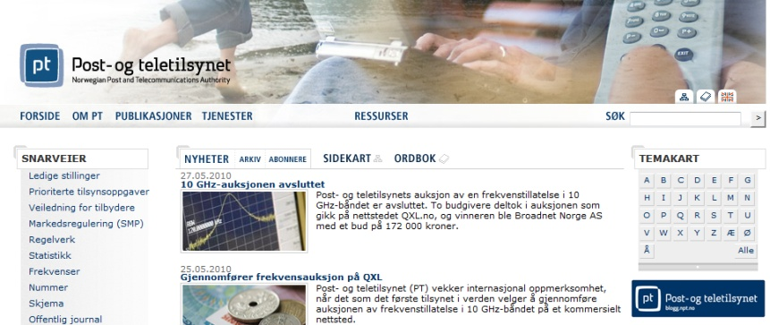
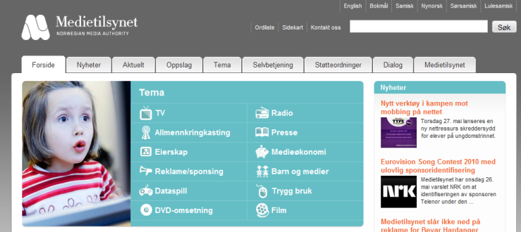
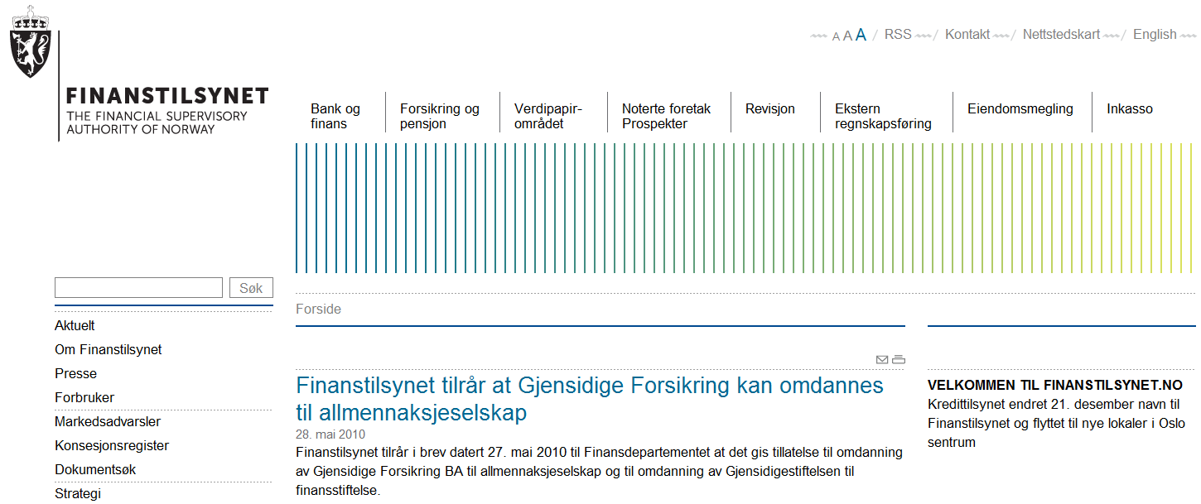
Challenges -service industry characteristics 1
Innovativeness
Service industry heterogeneity:
  Difficult to design innovation
  policy addressing the diversity of
  challenges in different SI’s?
Strict regulation:
  Does regulation approproately
  address innovation ?
Productivity

Slide 35
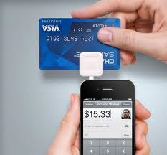

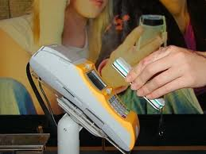

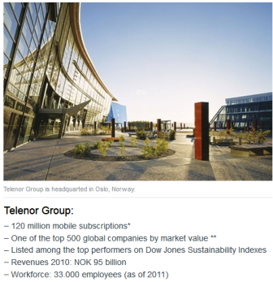
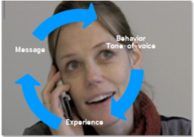

Challenges - service industry characteristics 2
Infrastructure:
  Do service innovation require
  access to infrastructures?
  Does the nacent entrepreneurship
  model break down?
Size and scale:
  Are service innovations rather a
  question of implementation and
  organizational change?

Slide 36





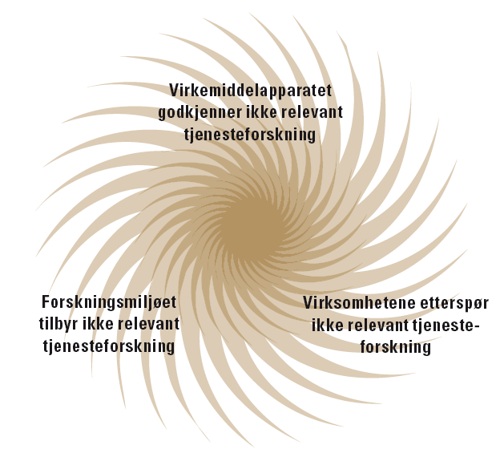
Challenges - service industry characteristics 3
Not cluster organized and mobile:
  Do the principles for understanding
  and facilitation regional innovation apply
  to services (at all)?
  Are large urban regions a precondition for SI?
  Is the innovation system completely different?
Other sources of innovation:
  Are technology and research driven innovation-
  systems less relevant for SI’`s?
  Does research fit the innovation needs of
  service firms?
  Other types of research?

Slide 37
1. General introduction to service innovation – the traditional perspective
Services – definitions, characteristics and perspectives
Service innovation – challenges and characteristics
Innovation management in service(s)

Slide 38
3. Managing service innovation at the firm level (de Jong et al, 2003)
Affected by firm level
management
Only partly affected by firm level
management

Slide 39



Conditions characteristics
Research suggests the service innovations conditions differ from other forms of innovation:
  Less driven by R&D
  More driven by customers
  Climate a more important condition
  People and multiple competences a more important
  determinant, knowledge driven – heterogeneity of the industry?
  Much service innovation driven by structural/
  infrastructural regulation?
Example, explanations of the US/EU productivity differences:
  Productivity difference explained by US service sector productivity
  Biggest explanatory factor ”multifactor productivity” in
  market services (e.g. trade, transportation, financial,
  business services, hotels, restaurants, personal services)
  “complex interactions between productivity,
  investment, and regulations.” (van Ark et al., 2008)
  E.g. regulation of retail trade (superstores etc.),
  liberalization of service trade, cultural differences
  (cultural heritage) etc.

Slide 40
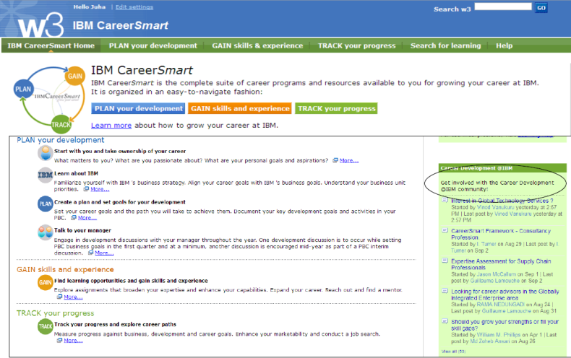
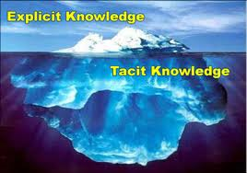
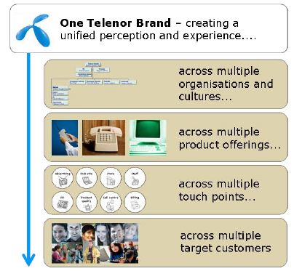
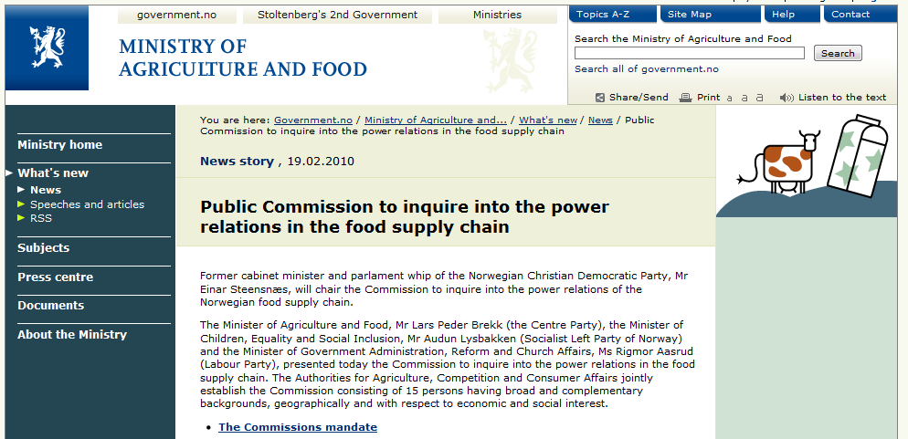
Managing SI conditions
Process
-
Process conditions – example actions…
  Design cross disciplinary teams
  Allow less formal structures
  Value intangible resources (knowledge)
  Stimulate open networking, control?
Climate conditions – example
actions…
  Facilitate customer oriented culture
  Use brand strategy as the ”mother
  of all strategies”
External conditions – example actions…
  Engage in public/private cooperation influencing regulation
conditions
:
•
People
•
Structure
•
Resources
•
Networking
Climate
-
related
conditions
:
•
Culture
•
Strategy
•
Company characteristics
External
conditions
:
•
Market
•
Knowledge
•
Government policy

Slide 41
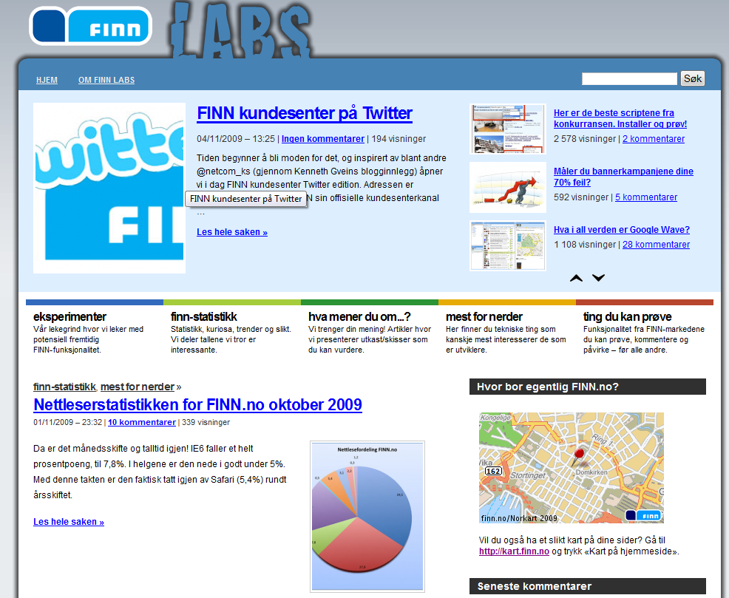
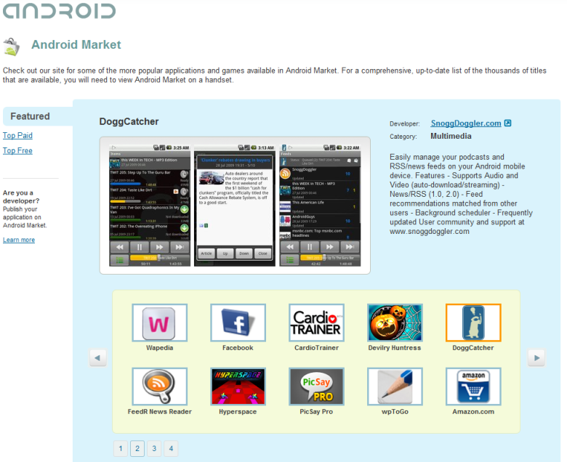
Process characteristics
Research suggests the service innovations processes differ from other forms of innovation:
  Less formal (are less formal or should be less formal?)
  Less stage-gated and more parallel
  More trial and error
  Blurring boundaries between search and implementation
More open and customer driven…
Just for
fun…
Serious
business…

Slide 42
Managing SI processes
Search – example actions:
  Use creativity techniques that fit service characteristics, e.g. jobs instead of functionalities
  Involve customers in search – co-creation, and customer involvement
  Use more experimental methodologies
Implementation -example actions:
  Modify NPD-processes to enable less stage gating and less formalization of steps (e.g. initiate and observe)
  Use more experimentation at the commercialization stage (e.g. no discrete launch)
Service
-
innovation process
•
Search
•
Implementation

Slide 43
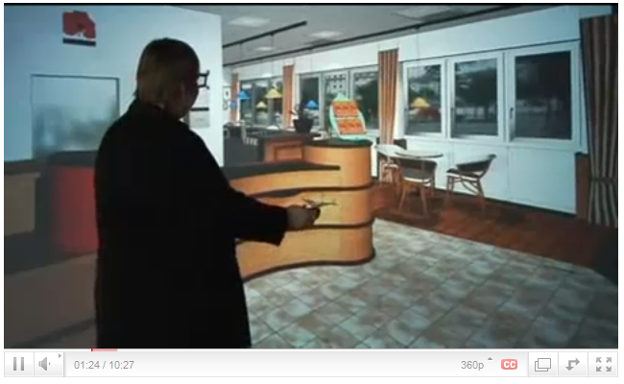
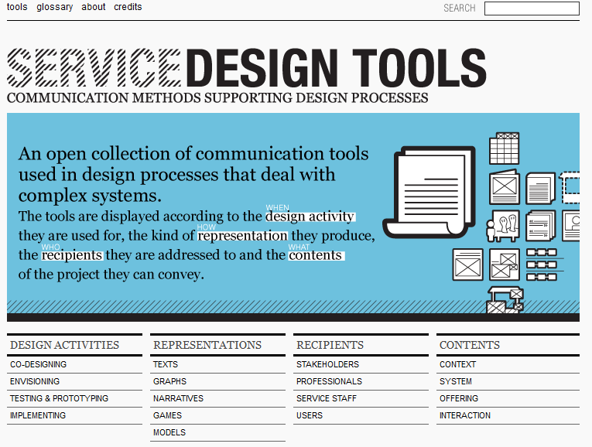
Service design methodology and experimentation
ServLab a ”theatre” environment
at Fraunhofer for service design

Slide 44
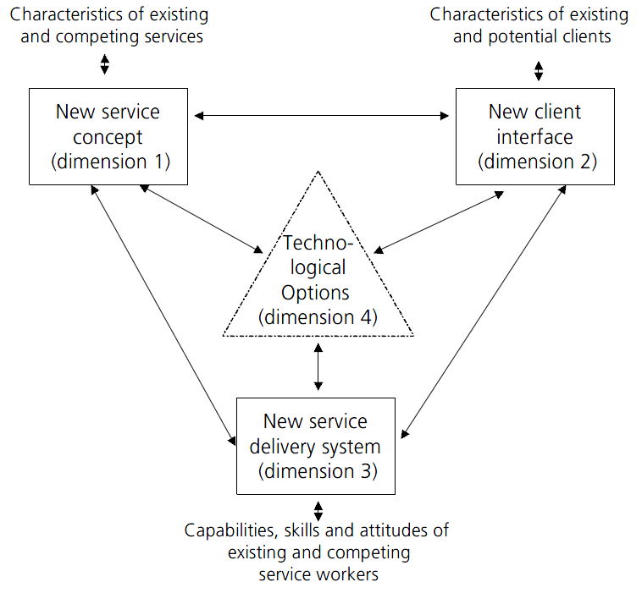
Innovation type characterstics
Research suggests the service innovations types differ from other forms of innovation:
  Does not fit the traditional product/process typology (product, process, organizational)
  More often
  simultaneously involves
  organizational innovations
  Incremental rather than
  radical (alternative types,
  see Alam, 2006)
Alternative typologies (e.g.
den Hertog, 2000,
modified by deJong, 2003):

Slide 45

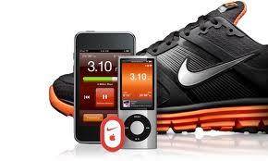
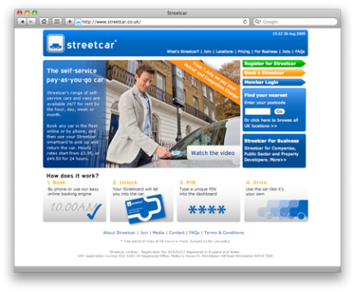
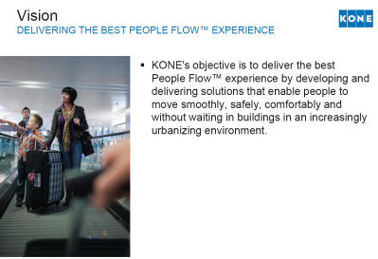

Managing SI types
Traditional management of:
  Service concept innovations (by innovations in value propositions)
  Client interface innovations (by innovations in self-service channels)
  Delivery system innovations (by understanding dematerialization and digitalization)
Managing innovation types not covered by this typology
  Product-service system innovations
  Customer innovations (more later)
  Business model innovations
  Combined product, service, organization innovations
Service innovation
:
•
Service concept
•
Client interface
•
Delivery system
•
Technology
vs

Slide 46
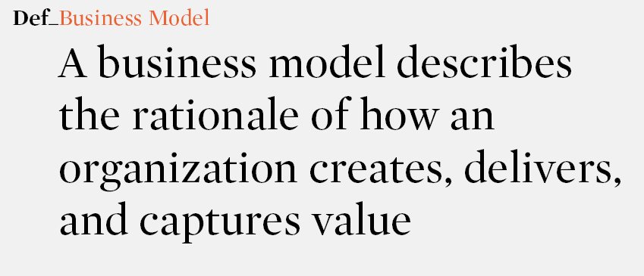
Managing business model innovations

Slide 47
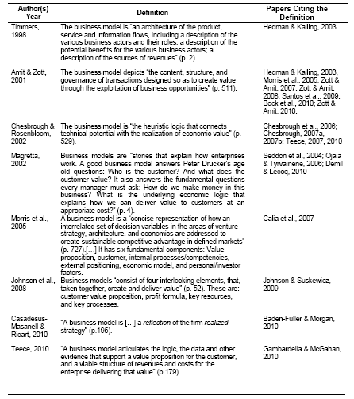
More business model definitions

Slide 48

Business model canvas

Slide 49








Business model innovation
The unique design and development of the components of a business model supporting the commercialization of an idea (new to the market)
An innovation in a single business model component (change and newness)
A transfer of a business model from another industry (new to the industry)
A replication of an exisisting business model (new to the firm)
A simultaneous change in most of the business model components and, consequently, the interactions between them (new to the firm, and sometimes to the market and industry)

Slide 50
Results/effects characteristics
Research suggests the effects of service innovations differ from other forms of innovation:
  More qualitative
  Longer term effects
  More oriented towards the customer
  Less focused on (short term) financial effects
  But still much focus on cost/productivity
No systematic review of potential effects until Aas and Pedersen, 2009:
Business process
effects
Capability
effects
Financial
performance
effects
Service innovation
process
Relationship
effects
Competitiveness
effects
External effects

Slide 51


Managing SI effects
Measuring
  Financial benefits
  Customer value
  Strategic success
Manage both ex ante and ex post measurement
Apply more complex ex ante value assessment methods
Apply more qualitative
ex post value essessment
methods
Effects
:
•
Financial benefits
•
Custome
r value
•
Strategic success
Business process
effects
Capability
effects
Financial
performance
effects
Service innovation
process
Relationship
effects
Competitiveness
effects
External effects

