Slide 1
SERVICE INNOVATION
NORSI
April, 2013

Slide 2
Content of my part
General introduction to service innovation issues
Service innovation approaches and challenges
Service innovation as innovation in service industries and as servitization
Service innovation and innovation systems
Service innovation management
Open innovation in service(s)
From services to service – towards a service dominant logic

Slide 3
Purpose
Give an overview of research issues of relevance to service innovation through examples of how research is conducted in the area
Give a deeper understanding of a selected set of research issues in service innovation, including approaches, service innovation definitions, methodologies, service characteristics, productivity, innovation systems, firm level service innovation management, open service innovation and service systems

Slide 4
2. Service innovation approaches and challenges
Service characteristics as a basis for characterizing service innovation
Approaches to understanding service innovation
Services productivity and innovation

Slide 5
1. Service characteristics as a basis for characterizing service innovation
Ref… definition in previous slides….
A service is the non-ownership equivalent of a good. Service provision has been defined as an economic activity that does not result in ownership and is claimed to be a process that creates benefits by facilitating either a change in customers, a change in their physical possessions, or a change in their intangible assets.
Typically characterized by the following (Zeithaml, Parasuraman and Berry, 1985):
Intangibility
Heterogeneity
Inseparability
Perishability
The IHIP characteristics…

Slide 6
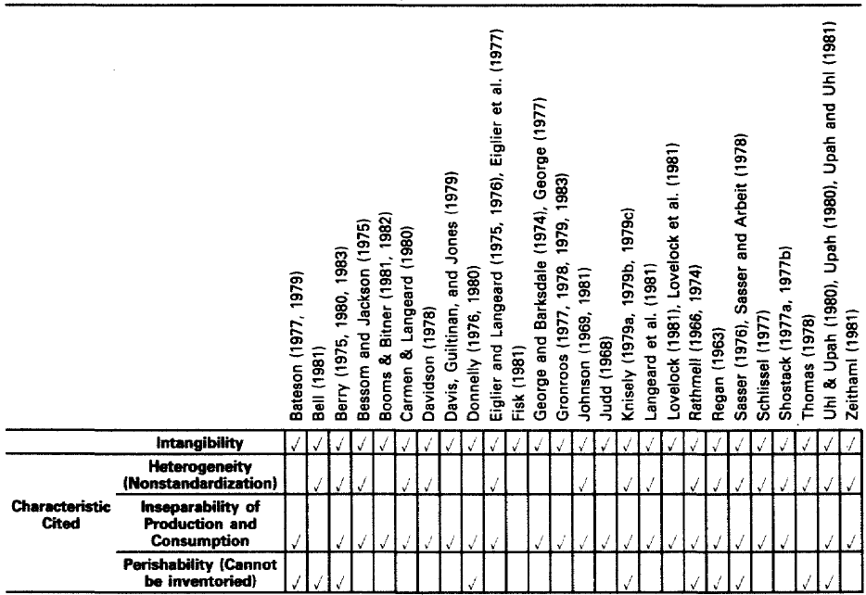
Zeithaml et al, 1985

Slide 7
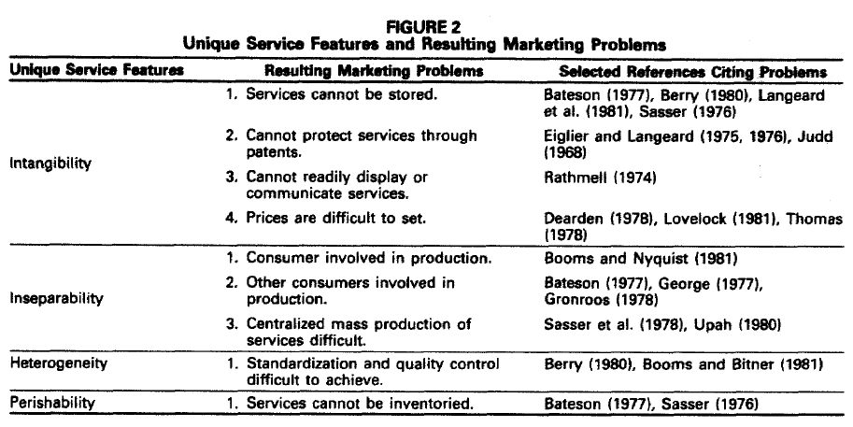

Slide 8
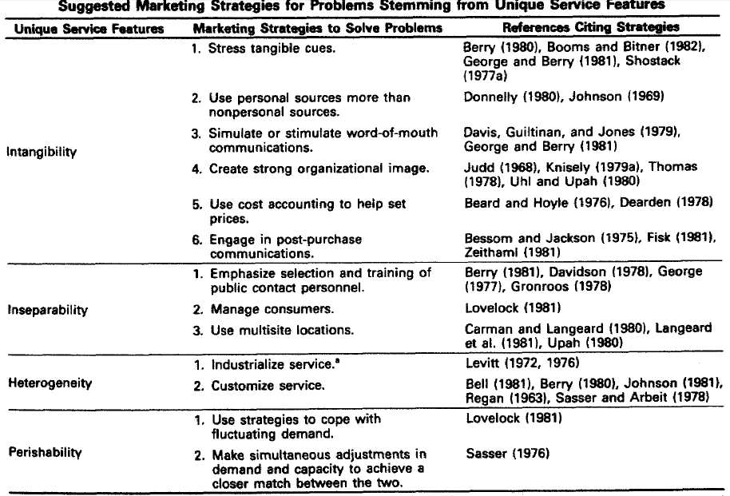

Slide 9
Zeithaml et al, 1985
Survey of N=323 respondents perception of problems resulting from IHIP and marketing tactics to overcome them
Investigation of differences in problem perception across firm types (customer type, geography, benefit characteristics, customer prescence)
Conclude that there are differences…
Argues for more research of service firm differences…
Argues that IHIP does not capture the most important problems facing service firms…

Slide 10
Lovelock and Gummesson, 2004
Still in the services marketing field
Question the relevance of IHIP
Their basis for differentiating services/service firms - generalizability
The relevance of these characteristics for a specific field of services marketing
Theoretical/conceptual study
Alternativ characteristics of services:
Ownership
Physical versus nonphysical acts
Information processing

Slide 11
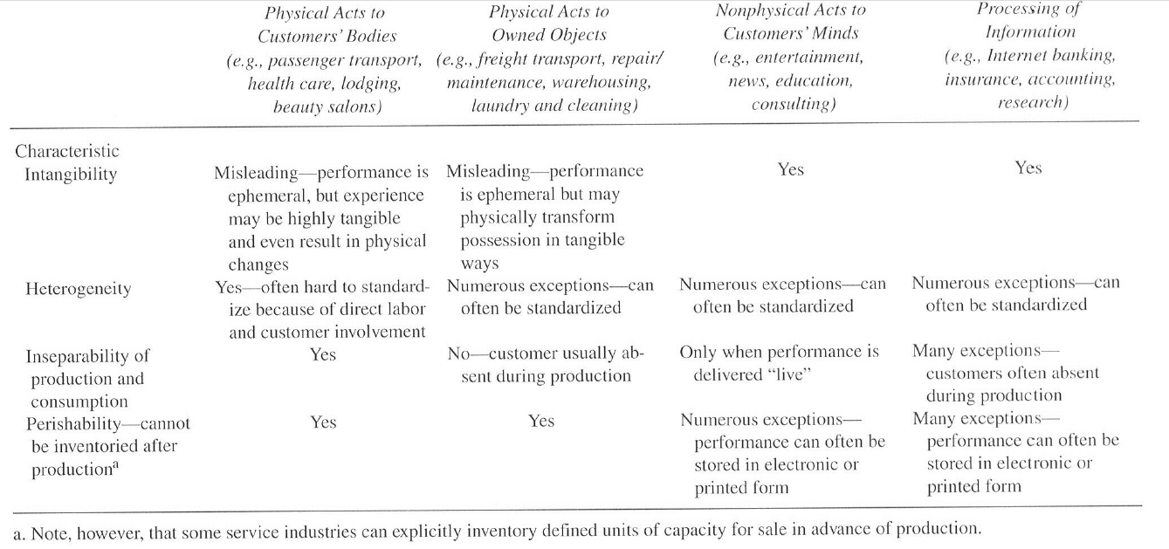
Critique (Lovelock and Gummesson, 2004)

Slide 12
Lovelock and Gummesson (2004)
Options:
Reject services marketing as a research (and practice) field
Focus individual subfields without a separate services marketing field, e.g. Contact based services
A new paradigm
L/G suggest a new paradigm:
Nonownership
Nonownership:
Different types of nonownership, basis for an alternative paradigm?
Example follow up – Lawson, 2011...

Slide 13
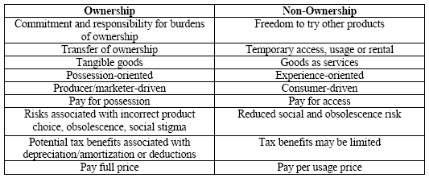
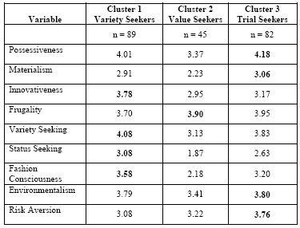
Theory of non-ownership consumption (Lawson, 2011)
Non-ownership forms along a continuum of value creation/exchange forms
Characteristics of non-ownership
Many forms of non-ownership consumption
A study of non-ownership motives:
Qualitative study – motives (N=12):
Freedom from ownership (burden reduction)
Value seeking (cost minimizing)
Variety seeking
Status seeking (e.g. handbag leasing)
Environmentalism (values)
Risk aversion (risk reduction)
Quantitative study – categories of transumers (N=216)

Slide 14
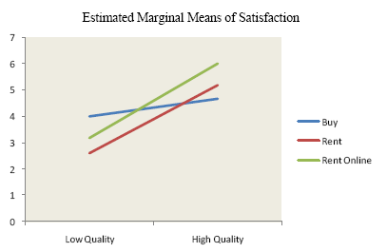
Theory of non-ownership decision making (Lawson, 2011)
Non-ownership consumption not much studied in consumer decision making
Some propositions (qualitative prestudy, tested in quantitative):
Less commitment to choice (no need to postpone, easier to justify decision, less need to justify etc.)
Other choice strategies (more satisfising, maximizing can be based on experience – try…, act, feel, think…)
Post-choice processing different:
Dissonance less often lead to regret
Fewer negative post-decision evaluations…?
Consequences not dramatic
Adjustments of expectations (lowered)…
More negative post-decision evaluations…?
Attribution to self not required, defending choice not required
Testing 1 versus 2 – not different for high quality, fewer for low quality (quality – ambiguity)

Slide 15
Service innovation implications
But does this have any implications for service innovation?
If IHIP can’t be used to categorize services they can’t be used to categorize service innovation… can’t IHIP be relevant to SI regardless of its categorization defects?
Can nonownership categories repace this? – Innovation is not discussed in L/G
Let’s turn to the service innovation litterature…

Slide 16
Approach taken in services marketing
A demarcation approach in which services are believed to differ systematically from manufacturing industries through the service characteristics
Applied to a variety of (marketing) problems in services, pricing, advertising, distribution… and service development …
New service development versus service innovation…
Other approaches?

Slide 17
2. Service innovation approaches and challenges
Service characteristics as a basis for characterizing service innovation
Approaches to understanding service innovation
Services productivity and innovation

Slide 18
2. Approaches to service innovation
Approaches to service innovation and innovation in services/service (coombs and Miles, 2000):
Transfer – assimilation (Sampson, 2004):
Product and service innovation share so many characteristics that theories, models and empirical results may be transferred from product innovation to service innovation.
Demarcation (Menor et al, 2002):
Product and service characteristics differ so much in their characteristics that it is also likely that innovation processes will differ too significantly for knowledge transfer to occur. Thus, specific theories, models and studies of service innovation are required.
Synthesis (Drejer, 2004; Coombs and Miles, 2000):
The blurring of products and services has come so far that even though products and services differ, it will be more fruitful to develop synthesized approaches to product and service innovation that both product and service innovation processes may profit from. Thus, synthesis theories, models and studies of innovation are required.

Slide 19
Approaches to understanding service innovation
Drejer, 2004 – Monica?

Slide 20
Approaches to understanding service innovation (Drejer, 2004)
Combination of review and position paper in RP
Reapplies the categorization of Coombs and Miles (2000) of assimilation, demarcation and synthesis:
To categorize service innovation studies (surveys)
Subordinate – assimilation, CIS, adaptations at best
Autonomous – demarcation, ref all our discussions previously
To apply some Schumpeterian principles on innovation:
Innovation not in terms of predefined category but economic impact (e.g. Online banking)
Multitude (breadth) of innovation types (ad hoc versus significantly improved, relationship innovation – partnership e.g. innovation in roles, formalisation innovation, e.g. Innovation in procedures, e.g. Cleaning))
But demarcation might be ”mingling activities that might lead to innovation with actual innovation”…

Slide 21
Approaches to understanding service innovation (Drejer, 2004)
Applying a Schumpeterian perspective may:
Help identify and study important innovations that contribute to qualitative development, not just growth
Help redefine what should be counted and studied in service innovation studies (a call for redefining radicality in the context of services)
In itself this is Dreijers (2004) contribution to how we should proceed along a synthesis approach…
Economic impact
Reproduceability
Radicalness in some sense

Slide 22
2. Service innovation approaches and challenges
Service characteristics as a basis for characterizing service innovation
Approaches to understanding service innovation
Services productivity and innovation

Slide 23
3. Services productivity and innovation
Services productivity
Services and market and system failures

Slide 24
1. Services productivity (Maroto and Rubalcaba, 2008)
Baumol’s disease – assumption 1 services are low productivity industries:
Baumol (1967, 1985, 1989) – Labour as a means versus an ends (e.g. measure service quality by time spent) – problem with productivity
A weak connection between productivity and prices (wages, see below)
Generalize to countries – Baumols disease
Critisism:
Indirect effects, ref KIBS
Applies only to consumer services, not business
The finding that some services show extraordinary high prod. growth
High emp growth
Norway
Normal
Low emp growth
Low prod growth
High prod growth

Slide 25
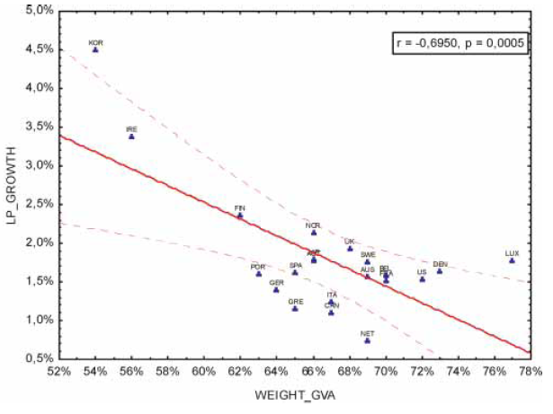
1. Services productivity (Maroto and Rubalcaba, 2008)
The productivity paradox and measurement:
”ICT is everywhere except in the productivity statistics” (Solow, 1987 and Brynjolfsson, 1993)
Particularly investments in the service sector
Measurement problem:
Intangibility of outputs and difficulty in controlling for service quality improvements
Difficult to control for quality of inputs under price falls (ICT as input)
Other problems (aggregate not firm level studies)
Services productivity:
Still ….

Slide 26
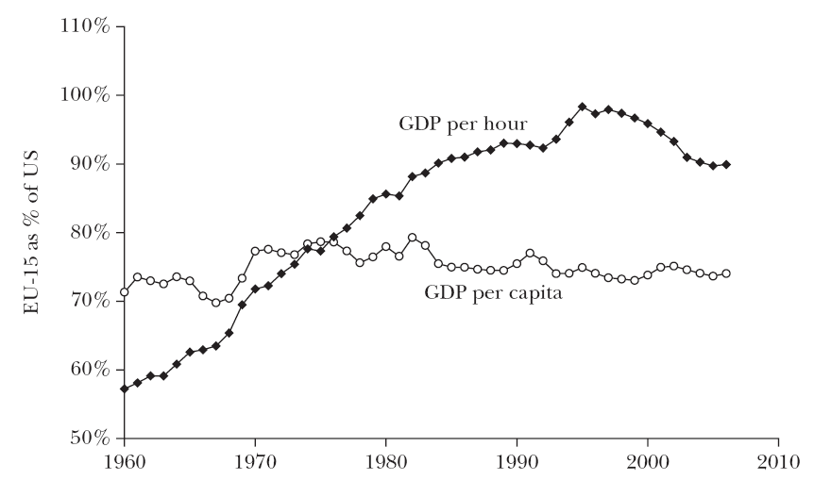
Development- US versus Europe
Cause(van Ark et al, 2008):
Much stronger growth in service productivity in US than in EU since 1995
… it is possible…
… with innovation …
Source Van Ark et al, 2008

Slide 27
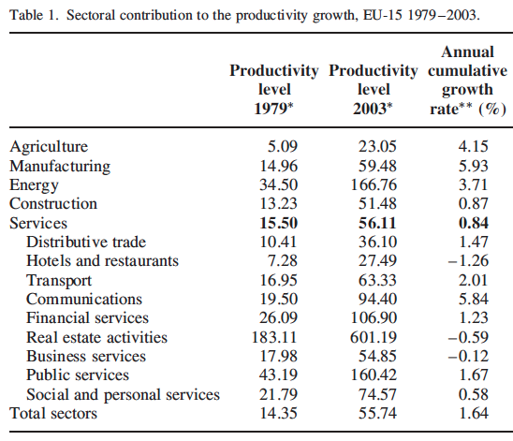
1. Services productivity (Maroto and Rubalcaba, 2008)
Services productivity cont…:
Large differences between service industries
Consequences for innovation policy
Research challenges: Measurement, innovation policy implications
RQ – How does the output measurement problems vary between service industries?

Slide 28
Maket and system failures in services (Rubalcaba, Gallego and den Hertog, 2009)
Market and system failures are primary rationale for innovation policy:
Assumption 1: Fewer failures in service industries, e.g. externalities
Assumption 2: Failures, but industries too heterogeneous to defend sectorial policies
Discussion of sources of failures and policy actions – conceptual contribution
Article organized by policy:
Regulatory policy (both narrow and broad innovation policy but regulatory)
Complementary policy (everything else)

Slide 29
Maket and system failures in services (Rubalcaba, Gallego and den Hertog, 2009)
Regulatory policy addressing for example:
Hard institutional failures, lack of innovation focus in regulations (e.g. Public procurement)
Market power failure due to extremely high or low concentration (e.g. Competition Authority)
Complementary policy adressing for example:
Weak and strong network failures (”cluster projects”, or ”anti-cluster projects”)
Externalities (e.g. KIBS externalities)
Alternative organization…

Slide 30
Market failures (e.g. Kox og Rubalcaba, 2007)
Failure | Service innovation (examples)
Market power | Concentration in certain service sectors, e.g. Telecoms, parts of retail trade Relationship between competition and innovation may vary across industries
Externalities | Network externalities in ICT, telecoms, financial services, KIBS?
Common ”goods” | Common services in transport and infrastructure (e.g. standards, ref tourism…)
Information asymmetry | Intangibility important source of information assymetry, e.g. In capital markets
Resource immobility | Service directive issues, many personal services are local services
Property rights | Knowledge and competence investments effects long term effects, difficult to protect. Brand as protection mechanisms, secrecy?

Slide 31
Systemic failures (e.g. Carlsson og Jacobsson, 1997)
Failures | Service innovation (examples)
Infrastructural failures | Investments in infrastructure not coordinated (e.g. Transport, ICT, telecoms, financial services (e.g. Broadband, externalities but also coordination failures)
Transition, lock in, path dependency failures | Lack of knowledge and competence, e.g. ICT (e.g. Home PC support)
Hard institutional failure | Innovation incentives not part of regulatory framework (e.g. Telecoms and financial services) Manglende hensyn til
Soft institutional failure | Lack og knowledge and understanding og service innovation in institutiions (Gustavson og Autio, 2006)
Strong network failures | Two strong ties or lack of diversity in shared knowledge (telekom, IKT, anti-cluster projects)
Weak network failures | Weak ties in potential service systems, lack of cluster basis – Balassa (not regional clusters, widened cluster project perspectives)
Capabilities’ failure | Generally lower education and qualifications in many services (education efforts)

Slide 32
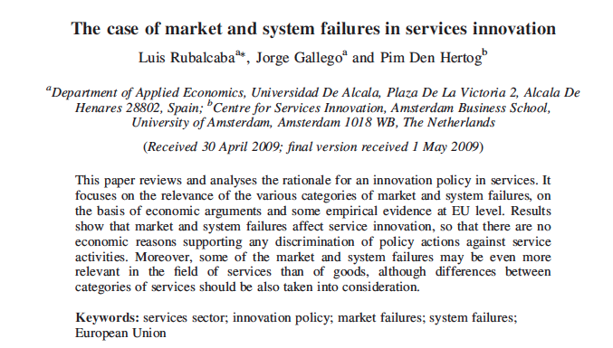
Maket and system failures in services (Rubalcaba, Gallego and den Hertog, 2009)

Slide 33
Summary
Service characteristics, debate over IHIP (and other characteristics) as a basis for service and service innovation categorization
Service characteristics still relevant as a research issue in service innovation, but not necessarily as a categorization/classification basis
Approaches to research on service innovation, problems with demarcation approaches and lack of basis for a synthesis approach
Two industry level research issues in service innovation, productivity and innovation, market failures in services and innovation policy consequences

