Slide 1
SERVICE INNOVATION
NORSI
April, 2013

Slide 2
Content of my part
General introduction to service innovation issues
Service innovation approaches and challenges
Service innovation as innovation in service industries and as servitization
Service innovation and innovation systems
Service innovation management
Open innovation in service(s)
From services to service – towards a service dominant logic

Slide 3
Purpose
Give an overview of research issues of relevance to service innovation through examples of how research is conducted in the area
Give a deeper understanding of a selected set of research issues in service innovation, including approaches, service innovation definitions, methodologies, service characteristics, productivity, innovation systems, firm level service innovation management, open service innovation and service systems

Slide 4
3 and 4. Service innovation, classification, servitization and innovation systems
Service innovation as innovation in service industries and as servitization
Service industries – classification of services based on patterns of service innovation
Knowledge intensive services
Servitization in manufacturing industries
Service innovation and innovation systems

Slide 5
1.1 Service industries – classification of services based on patterns of service innovation
Traditional classifications
A note on Norwegian classification(s)
The Hipp and Grupp (2005) study

Slide 6
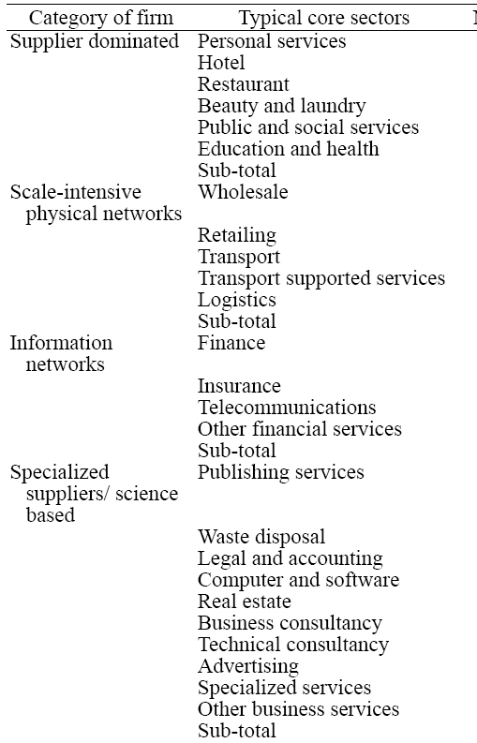
Classifying services in research – service industry characteristics
Soete and Miozzo (from Pavitt, 2001):
Supplier dominated (e.g. public and personal services)
Scale intensive physical networks (e.g. transport)
Network services (e.g. telecoms and banks)
Specialized services (e.g. KIBS)
In a study in 2005, Pedersen and Nysveen (2005) identified at least 40 different industry classifications applied in services (39 in Cook et al, 19999)

Slide 7
Pedersen and Nysveen (2005)
Soete and Miozzo, 1989 (original):
• Supplier dominated (personal versus public/social) (Restaurants, Laundry,
Beauty, health, education)
• Scale intensive (transport, wholesale)
• Information networks (finance, insurance, communications)
• Specialized supplier/science based (Software, specialized business services)
Bowen, 1990:
• High contact, customized, personal services
• Moderate contact, semi-customized, non-personal services
• Moderate contact, standardized services
Coombs and Miles (2000):
Dimension one: Transformation (this dimension is also used in Miles, 2004):
• Physical services (provided by physical assets) (hotel, restaurant, transport)
• Human services (provided by individuals) (counceling, hairdressing, surgery)
• Information services
Dimension two: Customization:
• Very high
• Medium
• Low
Evangelista and Savona (2003) :
• Technology users
• Science and technology based services
• ICT users
Evangelista and Savona (1998), Evangelista (2000):
• Technology users
• Science and technology based services
• Interactive services
• Technical consulting
Lovelock and Yip (1996)
• People processing services
• Possession processing services
• Information based services
• Supplemenary services
Innovation?

Slide 8
A Norwegian ”offspring”…
Econ/Menon assignment to classify services (2005)
Applied in the Menon analysis of service innovation (2010)
Service ”industries”
Problem solvers (consulting, accounting, close to trad KIBS) (innovation is knowledge driven)
Support services (cleaning, social welfare, property management) (innovation driven by standardization)
Manual network services (trade, transport) (innovation driven by standardization and scaling)
Digital network services (telecoms, financial services, ICT services) (innovation is somewhat knowledge and standardization driven, but mainly highly scalable)
Experiential services (hotels, restaurants, sports, art) (innovation is customer driven/based)

Slide 9
Classification of services through patterns of innovation
Hipp and Grupp (2005) - Joe

Slide 10
Classification of services through patterns of innovation
Hipp and Grupp (2005):
Focus on knowledge intensivation, but based on a traditional service industry perspective (demarcation)
Position, review, empirical, conclude, future research
Two contributions:
Characteristics of service innovation
Typology of service innovation patterns
Review – characteristics of service innovation (nonformal hypotheses):
Human factor (personal skills)
Non R&D innovation process
Multitude of innovation outputs (types)
Variation in intangibility
Customer integration (in innovation)
Industry characteristics (e.g. Size)
Regulation (some strictly regulated)

Slide 11
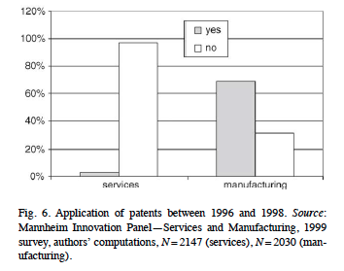
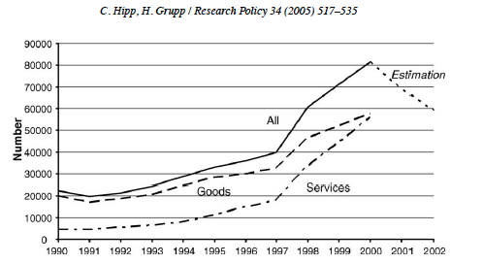
Classification of services through patterns of innovation
Hipp and Grupp (2005):
Empirical approach:
CIS equivalent surveys (data from several periods/waves)
Characteristics by CIS areas:
Inputs
Patents as a special issue
Outputs
Trademarks as a special issue

Slide 12
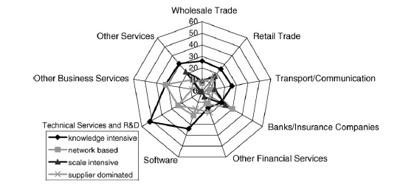
Classification of services through patterns of innovation
Hipp and Grupp (2005):
The typology (based on Pavitt, 1984, Soete and Mizzo, 1989):
Knowledge intensive
Network based
Scale intensive
Supplier dominated
Classification based on survey items (e.g. source of innovation), not predefined from NACE
E.g. Knowledge intensive, innovation from collaborating with research institutions
Difficult to reproduce the industry classification by the four types

Slide 13
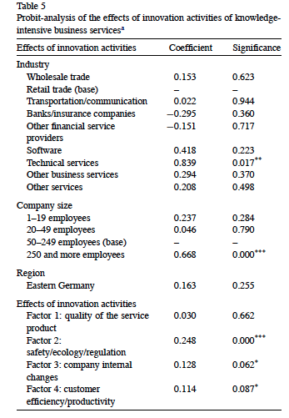
Classification of services through patterns of innovation
Hipp and Grupp (2005):
An alternative typology
Knowledge intensive
Not knowledge intensive
Measured by the output characteristics of innovation in KIBS, to what extent is the innovation pattern similar to that of KIBS (output/effects)
Conclusion:
Assimilation required, knowledge intensive innovation patterns of service firms
Colored by the current focus on KIBS…

Slide 14
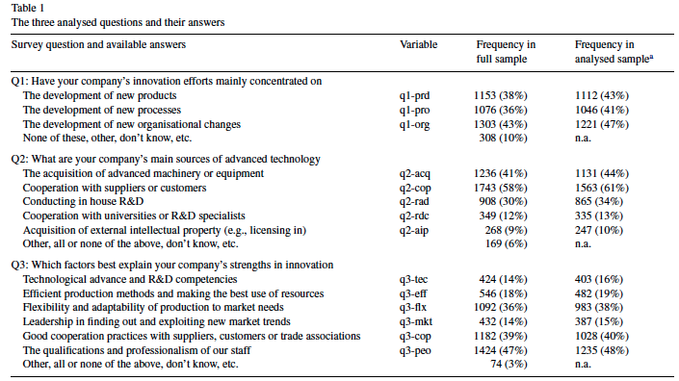
Tether and Tajar (2008)
Empirically driven classification study
Source: Innobarometer 2002
N=2578
Variables:
Innovation orientation
Innovation source
Innovation resource/ capability

Slide 15
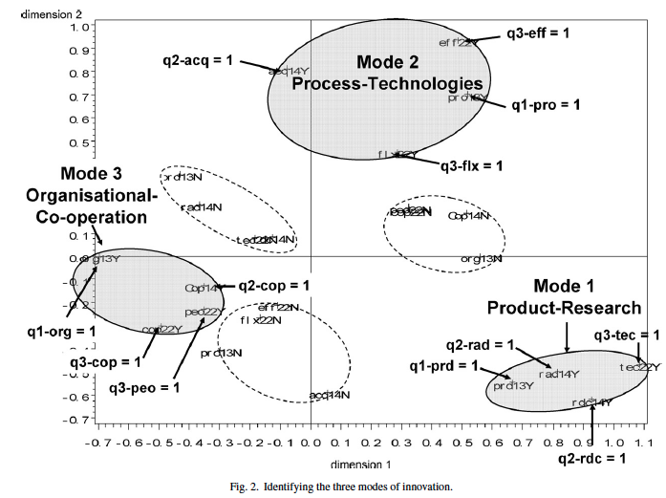
Tether and Tajar (2008)
Multiple correpsondence analysis (”factor analysis for categorical data”)
12 dimensions, but visualized with 2 dimensions:
3 modes:
Product Research
Process Technologies
Organizational Cooperation

Slide 16
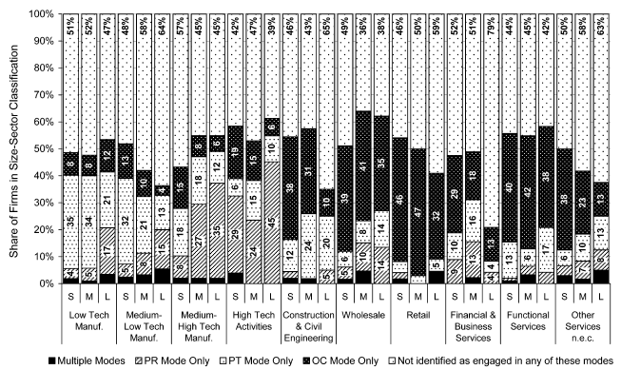
Tether and Tajar, 2008
Organization Cooperation overrepresented in Service industries
No sub- class

Slide 17
1.2 Knowledge intensive services
Different areas of research on knowledge intensive services:
Knowledge intensive Business Services (KIBS research)
Knowledge intensive Service Activities (KISA research)
Knowledge intensive Services (No particular research approach), ref. Hipp and Grupp (2005)

Slide 18
Services as knowledge intensive services
KIBS – Knowledge intensive business services: Research in late 90’s suggested that some services where unique:
With respect to growth
With respect to their innovativeness
With respect to their importance to innovation (in other sectors)
These were termed KIBS - Wikipedia: knowledge-intensive support for the business processes of other organizations. T-KIBS, (those with high use of scientific and technological knowledge - R&D services, engineering services, computer services, etc.), and P-KIBS, who are more traditional professional services - legal, accountancy, and many management consultancy and marketing services.
Aslesen and Isaksen (2007): it is a paradox that the large, supposed importance of KIBS does not show up more explicitly in quantitative innovation studies…
KISA – Knowledge intensive service activities

Slide 19
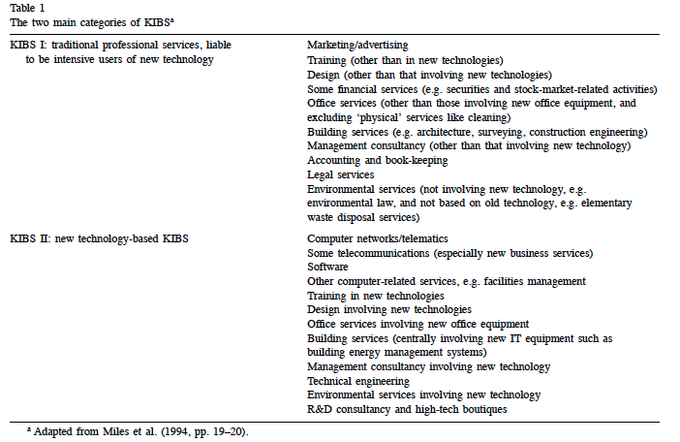
A heavily cited ”review” of KIBS research (Scholar 563 ao last week)
Muller and Zenker (2001):
Innovation system perspective (more later)
Two parts:
Review of literature
Empirical study

Slide 20
A heavily cited ”review” of KIBS research (Scholar 563 ao last week)
Hypotesize that KIBS play a significant role in the innovation system of SME’s through the production and dissemination of knowledge
Empirical study of manufacturing SME and KIBS in four regions in Germany/France
N= 1903 SME and 1144 KIBS
Acquisition
Codification
Interaction

Slide 21
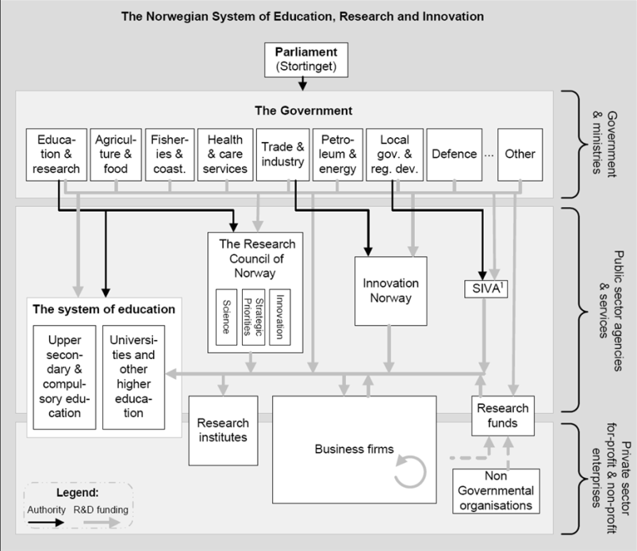
A traditional view of the innovation system…

Slide 22
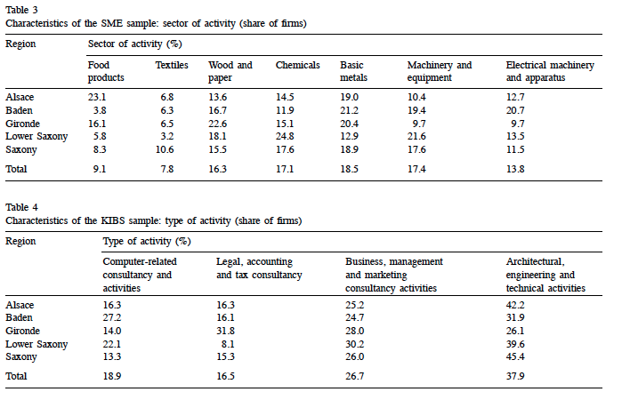

Slide 23
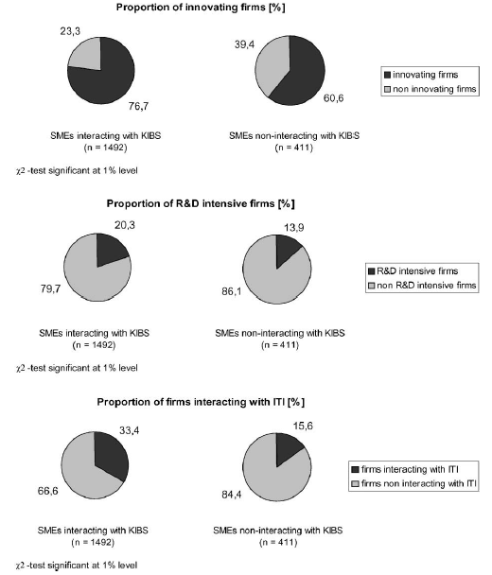
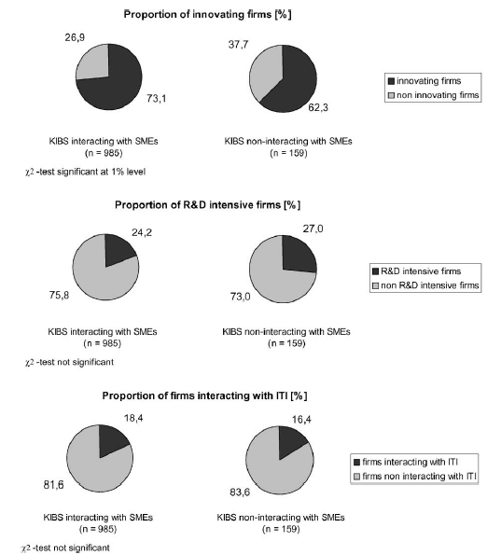
Simple study – interacting versus non/interacting
SMEs
KIBS

Slide 24
Conclusions
SMEs become more innovative, R&D intensive and ITI intensive through interaction
KIBS become more innovative but not more R&D intensive or ITI intensive with interaction
Some regional differences, KIBS interaction more influential in German regions, suggesting a link to national innovation systems diferences

Slide 25
Services as knowledge intensive services
KISA – Knowledge intensive service activities
Activities that can be carried out by external, specialized KIBS (Knowledge-Intensive Business Service firms) or in-house by employees of the firms using the KISA in question. They are all “knowledge-intensive” in terms of various indicators (Jones and Miles, 2008)
Differences (Aslesen and Isaksen, 2007):
Wider set of players
Market and non-market exchange
Co-production of knowledge (between provider and client)
Seem to play a significant role in innovation, but difficult to manage due to a combination of internal and external knowledge sources and various forms of exchange (e.g. innovation policy)

Slide 26
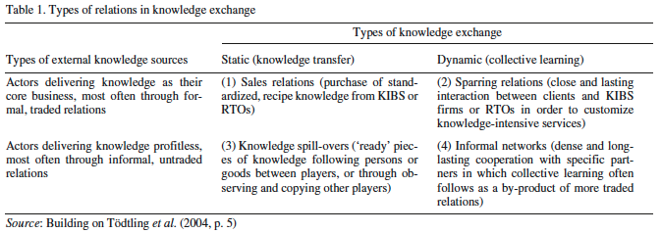
Aslesen and Isaksen, 2007
Innovation surveys rather suggest that many firms and organizations, regardless of being perceived as knowledge-intensive or not, may be important sources of knowledge-intensive services and information for firms’ innovation activity.
Institutional perspective – KIBS
Functional perspective KISA
Specialized providers (KIBS)
Non-specialized providers (clients and suppliers)
In house service providers
Exchange og knowedge based services
Market based exchange – static – transfer
Embedded relationships – dynamic – learning
Types may vary between sectors/industries

Slide 27
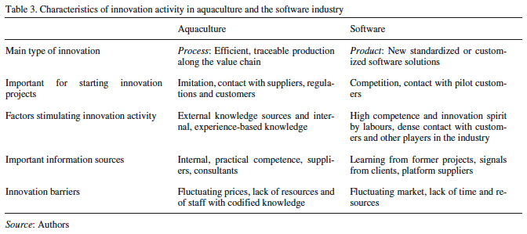
Aslesen and Isaksen, 2007
Empirical study
Qualitative study of informants in two sectors:
Aquaculture
Software
Findings:
Internal KISA most important for innovation
Dynamic exchange – embedded relationships are most important
KIBS are relatively unimportant in innovation activities (other activities)
Propositions of sector differences found little support

Slide 28
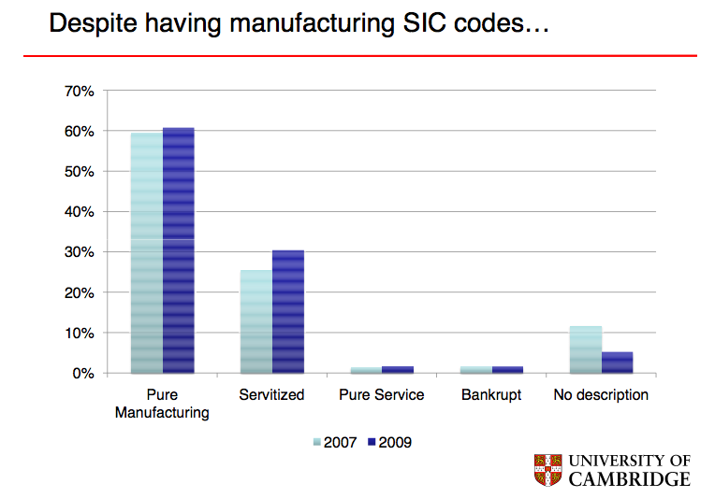
1.3 Servitization in manufacturing industries
Servitization
Servicizing (US)
Value added services
Product service systems
Outcome based contracting (e.g. Ng)
Service business models (e.g. Kindstrøm, 2010)
Service infusion (e.g. Edvardsson)

Slide 29
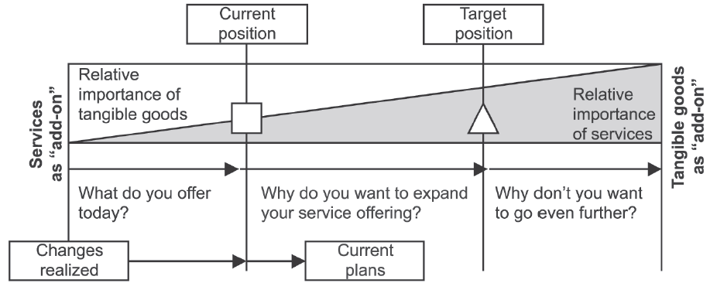
Servitization (Oliva and Kallenberg, 2003) and product-service systems (later)
A Product-Service System is an integrated product and service offering that delivers value in use (to be explained later).
Typical steps (for all goods producing firms):
Consolidating product-related services (internal efficiency)
Entering the installed base service market (define profit opportunity in services market itself)
Expanding to relationship-based services (co-production of client services)
or
Expanding to process-centered services (consulting, cover al brands etc.)
Taking over end-users operations (from paint producer to OEM paintline operations paid pr. car painted, Rolls-Royce’s “Power By The Hour”)

Slide 30
Baines et al. 2009
Review, 144 citations in Scholar
Classic review
Keywords: servitization
(e.g. service-centred, service-oriented, service integration, product support, integrated
solutions, post-sales, product-related services and after-sales).
Sources: Selected library databases
Period: 1988 – 2008
150 articles, books and reports reduced to 49 significant, cross referenced up to 58

Slide 31
Baines et al. 2009 - Findings
Definition:
Servitization is the innovation of an organisation’s capabilities and processes to better create mutual value through a shift from selling product to selling PSS.
Features/types:
There are various forms of servitization. They can be positioned on a product-service continuum ranging from products with services as an “add-on”, to services with tangible goods as an “add-on” and provided through a customer centric strategy to deliver desired outcomes for the customer. (Ref Oliva and Kallenberg, 2003)
Drivers:
Servitization frequently occurs because of financial drivers (e.g. Revenue stream and profit margin), strategic drivers (e.g. competitive opportunities and advantage) and by marketing drivers (e.g. customer relationships and product differentiation).

Slide 32
Baines et al. 2009 - Findings
Challenges:
The adoption of servitization by a conventional manufacturer principally presents challenges for service design (intangible, fuzzy), organisation strategy (product to customer) and organisation transformation (service culture) (ref totality of service business model, Kindstrøm, 2010)
Examples:
Examples of leading practice in the adoption of servitization are focused on larger companies supplying high-value capital equipment (e.g. Rolls Royce (PBH), not mentioned BEA (Tornado contract))
Normative support:
There is a paucity of previous work that provides guidance, tools or techniques, that can be used by companies to servitize.
The principal research need is to engineer tools or techniques that practitioners can apply to help in service design, organisational design and organisational transformation.

Slide 33
Summary of service innovation streams of research
Service innovation in traditional service industries – classification, taxonomies, surveys of innovation characteristics at the industry level, classification of innovation patterns
Service innovation in KI services, KIBS and KISA research
Service innovation in manufacturing industries – servitization research
More on these streams at the firm level later…

Slide 34
2. Service innovation and innovation systems
Ref KIBS and their role in innovation systems
Different types of innovation systems:
National innovation systems
Regional innovation systems
Technological innovation systems
Sectoral innovation systems
How should the innovation system of services be understood?

Slide 35
A traditional view of the (national) innovation system…

Slide 36
Services and the different innovation systems – broader perspectives
National innovation systems:
Ref the NIFUSTEP model on previous slide
Service innovations not R&D driven, firm and customer interactions important etc., patterns of innovation organizational – R&D?
Regional innovation systems:
Different versions and theories, geography and the regional aspect, clusters and the analytical knowledge aspect
Synthetic and symbolic knowledge based understandings of RIS more relevant to service innovation (analytic, synthetic, symbolic (Asheim)
But local demand more than regional knowledge important in many services (but not necessarily for service innovation)

Slide 37
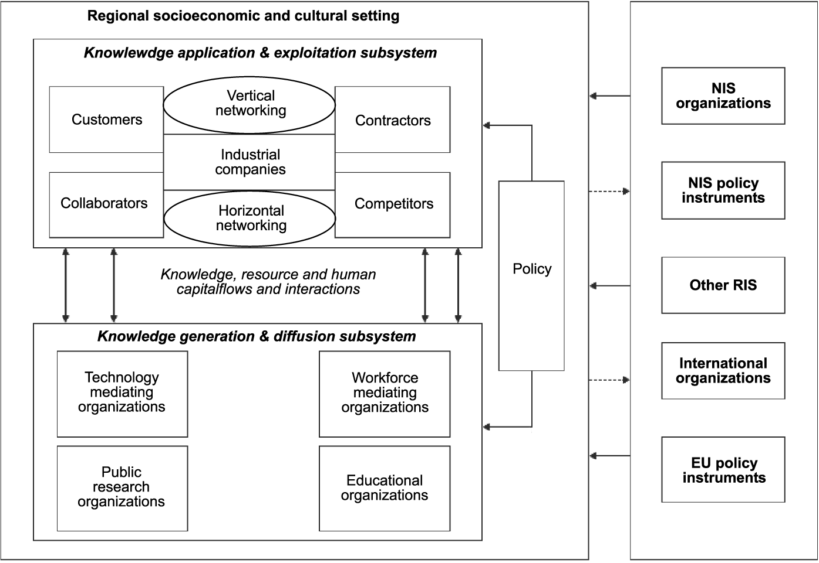
Tödtling & Trippl 2011

Slide 38
Services and the different innovation systems - narrower perspectives
Technological innovation systems:
Innovation systems organized around technology development and diffusion/application
Focused, dynamic, but technology not always source of service innovation (application rather than source, e.g. online banking and SMS/messaging)
Sectoral innovation systems:
Non regional, firm based perspective on the innovastions ystem, but limited to a specific sector
Service innovations often part of a larger product service system, e.g. Tourism, retail trade, experiential services, transport, not limited to a specific sector
But, lets ta a closer look…

Slide 39
Tether and Metcalfe, 2004
Tether and Metcalfe, 2004 - Lisa

Slide 40
Tether and Metcalfe, 2004
Based on the ESSY-project on sectoral innovation systems (Malerba, 2005)
Conceptual work positioning the results of the ESSY project to the service innovation community
Four parts/sections:
Identifying relevant characteristics of services
Summary of empirical work on sectoral systems of innovation
Generalize to services
Altenrative/new perspective on service innovation systems

Slide 41
Tether and Metcalfe, 2004
Identifying relevan characteristics of services and innovation:
Traditional characteristics
Services as transformation (activities) (physical form (repair), location (transport), information (financial, internet), etc)
Customers interpretation of value (heterogeneity)
Review of taxonomies of service innovation
Summary of empirical work on sectoral systems of innovation:
Airports – innovations as co-produced, innovation system as dynamic
Health – complementory developments of physical, behavioral and structural/organizational entities (cross level)
Retail distribution – interlinkage between business models, organisation and technologies (firm and network level)
Generalize to services
Alternative/new perspective on service innovation systems

Slide 42
Tether and Metcalfe, 2004
Generalize to services:
Interaction between artifacts and procedures
Evolving boundaries of the innovation system
Networked innovations, often structural and regulation involved
The role of institutions
Interaction between offering and demand
Local service production but non-local innovation
Alternative/new perspective on service innovation systems:
Innovation systems centered around problems or opportunities, not sectors or national institutions
Entities of the innovation system institutions, actors, practices, procedures, roles, norms, incentives etc, not just institutions or actors
The dynamic nature of this system

Slide 43
