Slide 1
SERVICE INNOVATION
NORSI
April, 2013

Slide 2
Content of my part
General introduction to service innovation issues
Service innovation approaches and challenges
Service innovation as innovation in service industries and as servitization
Service innovation and innovation systems
Service innovation management
Open innovation in service(s)
From services to service – towards a service dominant logic

Slide 3
Purpose
Give an overview of research issues of relevance to service innovation through examples of how research is conducted in the area
Give a deeper understanding of a selected set of research issues in service innovation, including approaches, service innovation definitions, methodologies, service characteristics, productivity, innovation systems, firm level service innovation management, open service innovation and service systems

Slide 4
5. Service innovation management
Service innovation and new service development
Service innovation management – types, processes and resources – dynamic capabilities
Managing servitization
Managing innovation in experiential services
Open innovation in services … next section

Slide 5
1. Service innovation and new service development
Service innovation management (practices) often studied under the term ”new service development” (NSD) (corr. NPD)
Reviews of SI management must cover both terms
Research streams and issues – let’s look at a recent review (Droege et al., 2009)

Slide 6
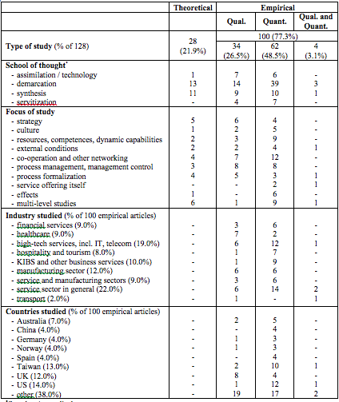
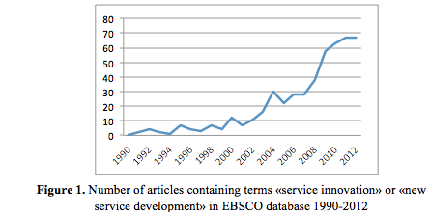
Droege et al., 2009
Classic review
Search terms ”service innovation” and NSD
ISI WoS as source
Unclear reporting of articles, but Kurtmollaiev and Pedersen (in press):

Slide 7
Droege et al, 2009
Approaches/schools of thought:
Technologist (assimilation), demarcation and synthesis
Fields of research
Taxonomies of service firms
Classification of innovations (types not patterns)
NSD success factors (no real framework, e.g. IPO type)
Let’s look at the last two fields…

Slide 8
Classification of innovation types
Break product/process
Gallouj and Weinstein (1997):
Radical innovations, incremental innovations, improvement innovations, combinatory (architectural) innovations, formalization innovations, and ad hoc innovations
Den Hertog (2000):
New service concept dimension, new client interface dimension, new service delivery system dimension, and technological options dimension
Den Hertog most widely applied but still active research to identify and classify service innovation types

Slide 9
Success factors (SI management…)
No IPO framework (applied in K/P, in press, matured)
Service dimensions (multiple):
Frohle and Roth (2007): Resource oriented versus process oriented practices
Menor and Roth (2007): process, market, strategy, structure, (IT) experience (knowledge)
Developed into more tidy IPO frameworks (soon)
Degree of radicalness (process):
Still no clear knowledge status (degree rather than kind)
Contrasting NSD and NPD success:
Fomalization still important issue (descriptive and normative)
Sources still an issue (R/D, customer etc.)
What about resource conditions?

Slide 10
I/R
P
O/E

Slide 11
2. Service innovation management – types, processes and resources – dynamic capabilities
The Frohle and Roth (2007) and Menor and Roth (2007) articles paved way for much more focus on both resource related (and process related) NSD management practices
Examples of resource related issues in NSD/SI:
Strategy (e.g. corporate and innovation strategy fit), culture (corporate and innovation culture fit, customer oriented culture), capabilities (alternative forms of capabilities for SI)
Let´s take a look at one of these – dynamic capabilities…

Slide 12
Den Hertog et al, 2010
Den Hertog et al., 2010 – Nhien…

Slide 13
Den Hertog et al, 2010
Position /conceptual paper (will be much cited)
Offers a framework for service innovation management consisting of:
Service innovation types (termed dimensions)
Dynamic capabilities required to manage them
Links to firm level organizational units and procedures
(Takes away the breath of the reader at once….. but published anyway so there is hope…)

Slide 14
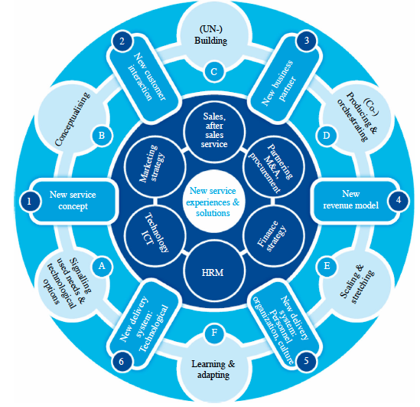

Slide 15
Den Hertog et al, 2010
Service innovation dimensions – types
New service concept – e.g. bundles, brand stores, designer hotels
New customer interaction – e.g. online or mobile banking, self services
New value system/business partners - e.g. mobile apps platforms
New revenue models – e.g. software as a service, freemium models, adveritising based models
New organizational service delivery system – e.g. call centers, branded support communities
New technological service delivery system – e.g. micro and ready made, streaming services, digital payment services

Slide 16
Den Hertog et al, 2010
Dynamic capabilities
Introduce RBV and DCV
RBV - The bases for competitive advantage are essentially resources that meet the valuable, rare, inimitable and non-substitutable (VRIN) criterion and give rise to “fresh value creating strategies that cannot be easily duplicated by competing firms” (Eisenhardt and Martin, 2000, p. 1105)
DCV - He (Teece) proposes three categories of dynamic capabilities that he sees as most critical for sustaining evolutionary and entrepreneurial fitness [10], i.e. the capacity to sense and shape opportunities and threats, to seize opportunities and dynamic capabilities to maintain competitiveness through enhancing, combining, protecting and, when necessary reconfiguring the business enterprise’s intangible and tangible assets (Teece, 2007, p. 1319).

Slide 17
Den Hertog et al, 2010
Applies it to SI/NSD:
Signalling user needs and technological options (understand users/customers and utilize new technological options (signal))
Conceptualizing (turn ideas into concepts that can be communicated and tested despite intangibility)
(Un)-bundling capability (combining services into and unbundling services despite problems of modularization of services, growing research area)
Co-producing and orchestrating (networking and network management)
Scaling and stretching (scaling as diffusion, stretching as brand extensions)
Learning and adapting (systematic framework for testing, evaluating and learning)

Slide 18
Other general success factors still debated
Resources:
Strategy and innovation strategy, growth versus innovation, gazelles, entrepreneurs and innovators
Culture, innovation oriented culture in service firms
Process:
Customer involvement in innovation
Process formalization, portfolio management and management control
Innovation types:
Organizational and business model innovations still not sufficiently captured in frameworks like e.g. Den Hertog et al., 2010 (ref previous discussion on service business models Kindstrøm, 2011)
Effects
Qualitative versus quantitative effects, competitive advantage versus financial effects, effects measurement and management control/incentives in service organizations
Some of these issues will be discussed later and also by Pelle…

Slide 19
3. Managing servitization
Servitization excluded from the Droege et al (2009) review
Separate field of research, but should be included in from a synthesis perspective
Servitization as a phenomenon covered in Baines et al (2009)
Lets look at some firm level aspects of servitization, e.g. management in terms of effects…

Slide 20
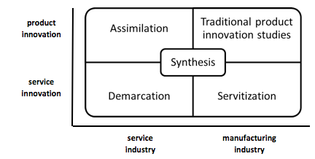
Kurtmollaiev and Pedersen, inPress

Slide 21
Gebauer et al. (2011)
Gebauer et al. (2011) - Erik

Slide 22
Gebauer et al. (2011)
Researchers from CTF
Servitization as a strategy
Empirical paper in JBR
Traditional paper in terms of theory, hypothesis development, method, measurement and analysis
Managerial in perspective and literature base

Slide 23
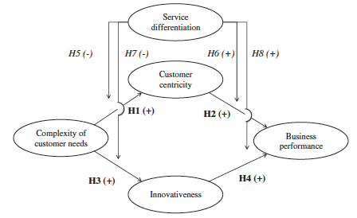
Gebauer et al. (2011)
Theory:
Tradition of market orientation (Narver and Slater, 1990)
Servitization or service differentiating strategy effects may interact with aspects of market orientation, such as customer centricity and innovativeness
Proposed interaction is moderation
Model:

Slide 24
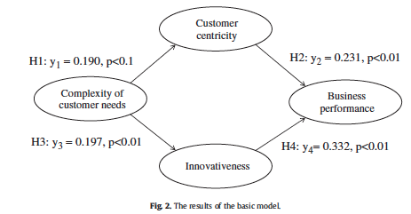
Gebauer et al. (2011)
Hypotheses:
Main hypoteses of direct effects of customer needs on centricity and innovativeness and centroicity and innovativeness on performance
Moderating effects of service differentiation on all direct effects
Method:
Survey of European firms, N=332
Questionnaire (common method partly controlled)
Indep concepts measured by 2-4 item scales
Dep concept measured by 2 item subjective scale
Analysis
Measurement model validation - confirmatory
SEM modeling, test for mediation model (what do you think?)
Moderation – three moderator hypotheses sign, performance effects of service diff
Implications

Slide 25
Gebauer et al. (2011)
Findings (performance):
Customer centricity positively affects business perfomance
This relationship is stronger for servitization companies, thus their performance depends more on customer centricity
Innovativeness affects business performance
Servitization does not seem to moderate the effect, but multigroup analysis shows positive moderation of high/low servitization and no effects of medium
”Stuck in the middle” finding..

Slide 26
4. Managing innovation in experiential services
Some services are believed to differ significantly in their source of innovation – experiential services
A wave of focus on experience – i.e. The customer experience in marketing literature:
Consumer experience
Consumer brand experience
Customer experience
Brand experience
Innovations in the customer experience as a source of differentiation – CSI research topic
Innovation management – What can we learn from the innovation management of experiential services?
Managed touchpoints
Indirect experiences
Product/ service
Product/service experience
Customer experience
Brand experience

Slide 27
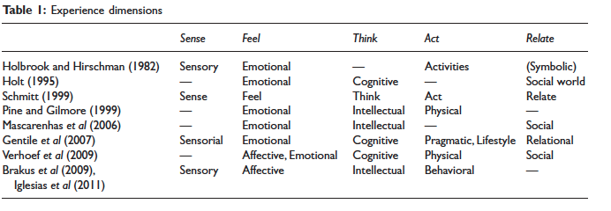
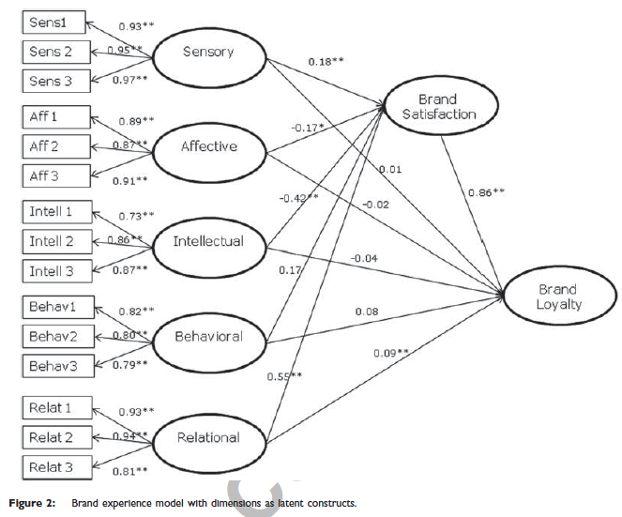
Experiential services
What is a brand experience (Brakus et al., 2010, Nysveen et al, 2012)
5-dimensional concept
A model test:
Relationship dimension only dimension that adds to brand loyalty beyond brand satisfaction
Examples, Starbucks, Nike, Disney, Apple, CocaCola…
But innovation ?

Slide 28
Zomerdijk and Voss, 2011
Qualitative study of experiential service providers innovation management practices
Zomerdijk’s PhD with Chris Voss supervising
Published in JPIM and JSR
Characteristics of experiential services:
High experiential content (attributes, evaluation)
Experiential interaction rather than functional benefits
Ref brand experience measurement
Zomerdijk and Voss, 2011 - Trond

Slide 29
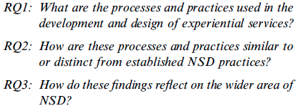
Zomerdijk and Voss, 2011
RQ’s
Theory:
Applies the framework og Frohle and Roth (2007) to focus 5 dimensions: process, market research, design tools, metrics/measurement and organization
Propositions:
NSD processes in experiential services need to be both systematic and flexible.
Market research for the development of experiential services requires empathic and ethnographic approaches
Experiential service design employs tools that focus on the experiential and emotional aspects of service delivery
The development of experiential services requires metrics to assess the emotional components of the customer experience
The development of experiential services requires cross-functional teams and involvement of frontline employees

Slide 30
Zomerdijk and Voss, 2011
Method:
Sampling, experiential services (9) and design agenies/consultants (8), N=17
Case study with 40 interviews in the 17 companies, 1 to 1.5 hours, recorded and transcribed. Software used for coding
Findings:
Designers – front end and structured process, same for SP’s but much less documentation, differences in tightness of process, but very passionate of their process
Use traditional market research, but designers more empathic research. Learning from others and trend analysis not expected, new prop.
Customer journey mapping widely applied, to some degree storytelling and metaphors, to a lesser degree prototyping
Little evidence to support experiential metrics being applied – lack of metrics?
Innovation responsibility desentralized, cross functional and frontline, but even broader engagement typical, new prop.

Slide 31
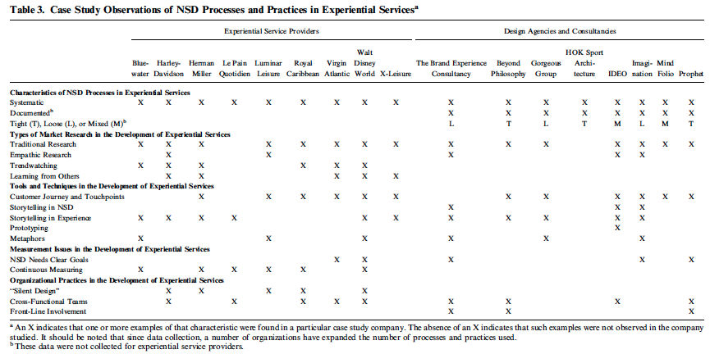

Slide 32
Zomerdijk and Voss, 2011
Conclusions and implications:
Not all that different from non-experiential NSD
Some due to the characteristics of ”intangible, personal, emotional, and spanning many different touchpoints across organizational functions”, but relevant also for other SP’s
Propositions refined, but requires further validation before normative implications
Experiential NSD versus NPD/nonexp NSD:
More focus on service process than product
Conflict between formalization and ad hoc nature of NSD
Incremental innovations dominate

Slide 33
Summary – innovation management
Review of issues
Examples of research representative of recent areas of interest and methodological approaches:
Dynamic capabilities and resources rather than processes
Servitization and the challenges and effects of SI in manufacturing firms
Experiential services and using customer experience as the source of innovations

