Slide 1
SERVICE INNOVATION
NORSI
April, 2013

Slide 2
Content of my part
General introduction to service innovation issues
Service innovation approaches and challenges
Service innovation as innovation in service industries and as servitization
Service innovation and innovation systems
Service innovation management
Open innovation in service(s)
From services to service – towards a service dominant logic

Slide 3
Purpose
Give an overview of research issues of relevance to service innovation through examples of how research is conducted in the area
Give a deeper understanding of a selected set of research issues in service innovation, including approaches, service innovation definitions, methodologies, service characteristics, productivity, innovation systems, firm level service innovation management, open service innovation and service systems

Slide 4
6. Open innovation in services
Open innovation, alternative definitions and examples
Services and open innovation – open service innovation?
Example article – West and Gallagher, 2006
Example article - Oliveira and Von Hippel, 2011

Slide 5
1. Open innovation ala Chesbrough (2006)
Def… (Chesbrough, 2003): ”a paradigm that assumes that firms can and should use external ideas as well as internal ideas, and internal and external paths to market, as the firms look to advance their technology”

Slide 6
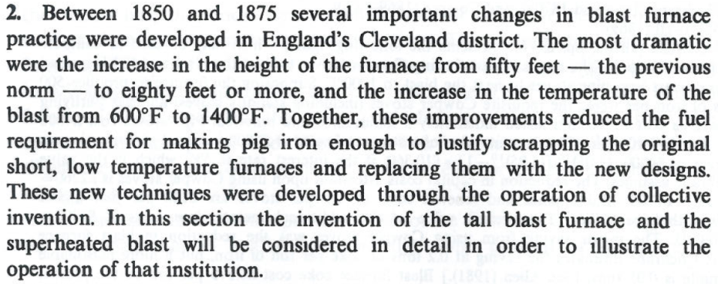
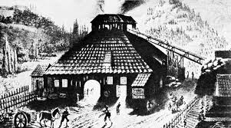
How new is ”open innovation”?
Teece, 1988 on independent research institutes
Allen, 1983 on ”collective invention” in blast furnace technology

Slide 7
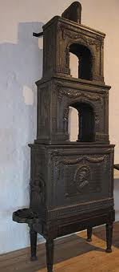
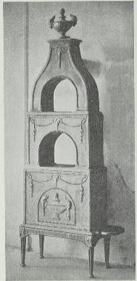
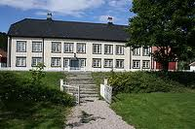
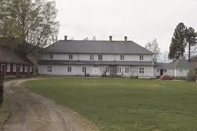
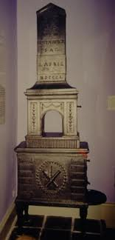
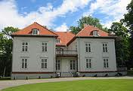

Slide 8
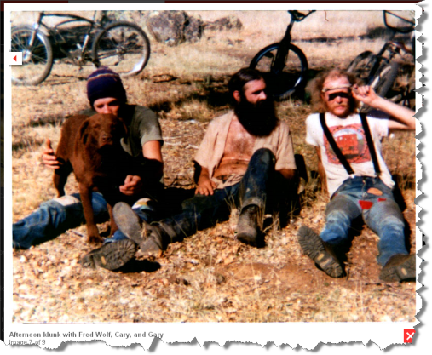
How new is ”open innovation”?
Teece, 1988 on independent research institutes
Allen, 1983 on ”collective invention” in blast furnace technology
Von Hippel, 1986 on user innovation, e.g. ”mountain bikes”

Slide 9
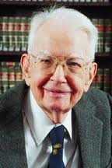
Economic/strategy theory
Teece (1986, 2006):
1. Competition- protect (TC)
If uncertainty is high, frequency is low and there is a danger that other companies may capitalize on the invention/idea, keep innovation internal.
2. Complementarity– control (RBV)
If other actors/companies have the resources required to commercialize the inovation, try to gain control over these resources.

Slide 10
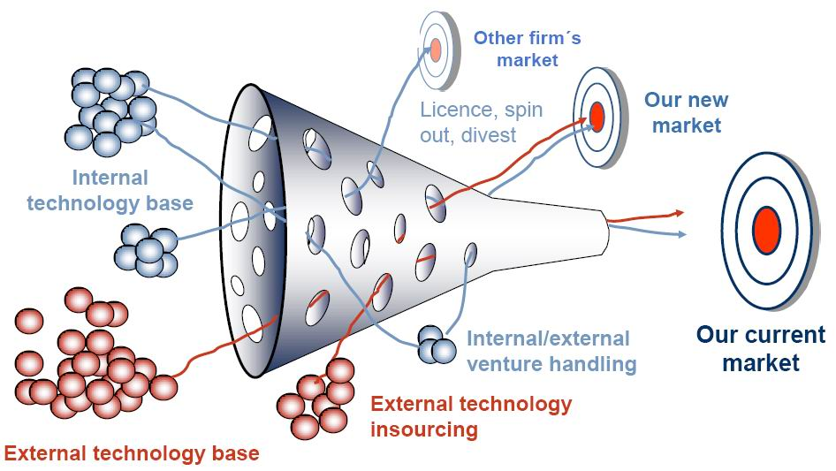
Open innovation ala Chesbrough (2006)

Slide 11
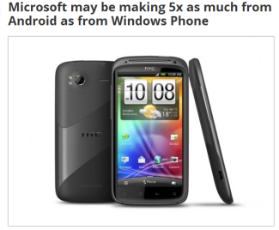
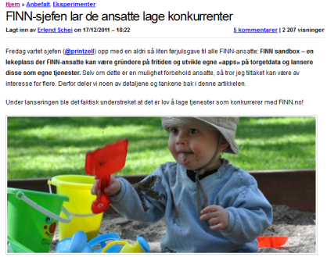
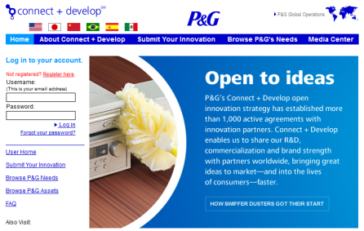
Open innovation ala Dahlander (2010)
Inbound
Outbound
Pecuniary (Market)
Buying patetnts for own development
Licensing technology out that we will not utilize ourselves
Developing ideas together with suppliers and distributors
Open sharing of technology
Non-pecuniary (Non.Market)

Slide 12
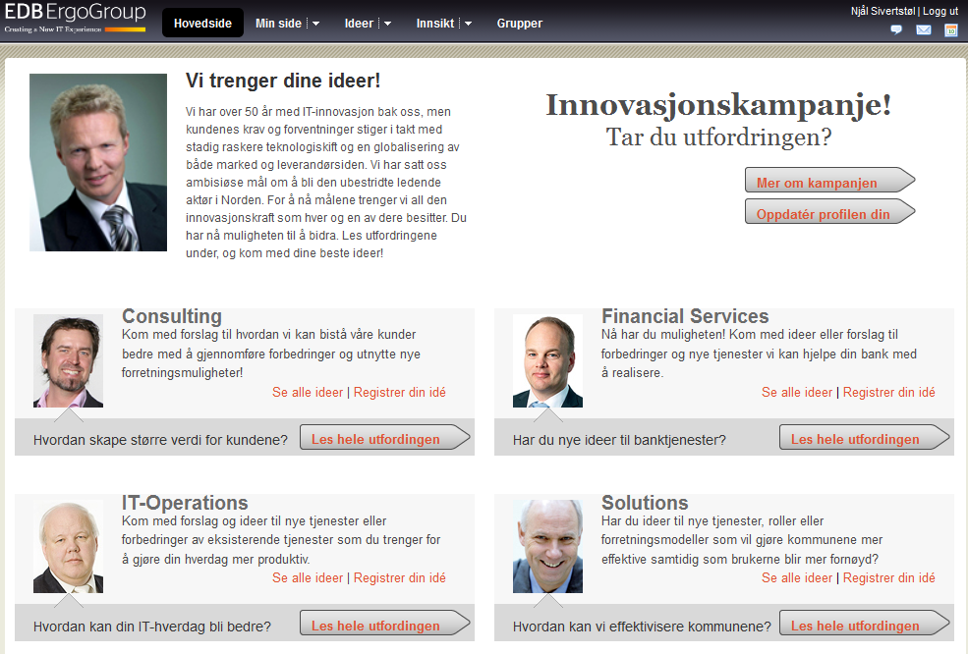
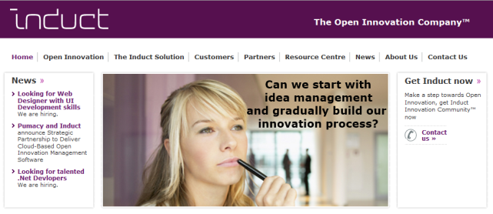
More than strategic use of external sources and paths to commercialization
Open innovation isalso about internal openness….
Open innovation is also open innovation processes between sourcing and paths to commercialization….
Open innovation is a model of innovation that crosses firm level boundaries – e.g. open innovation communities/spaces and open business models…

Slide 13
But where are the customers and consumers, I thought open innovation was all about democratizing innovation?

Slide 14
The relationship between open innovation and co-creation…
Innovation
User innovation networks
User innovation
Open innovation
Democratizing innovation
Collective invention
Living labs
Open source
Crowdfunding
User driven innovation
User centric innovation
Upstream participants
E.g. Suppliers
Social entrepreneurs
Downstream participants
E.g. Customers
Employees
Collaborative consumption
Co-Creation of value
Crowdsourcing
Prosumption
Co-Production
”Production”

Slide 15
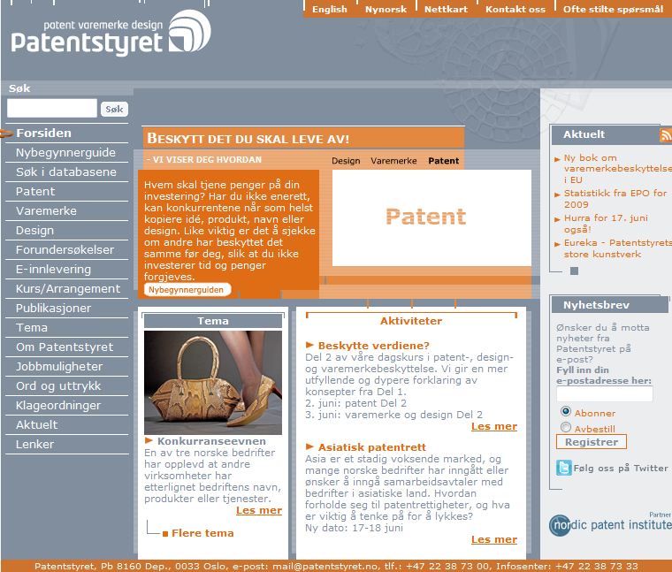
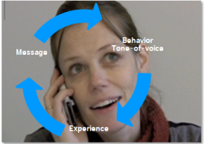
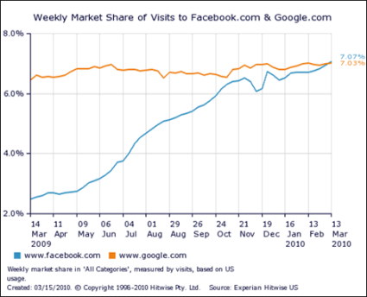
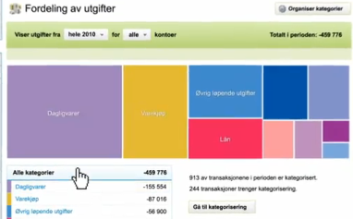
2. Open innovation and the characteristics of services
Intangibility:
What flows in and out of the open innovation process?
How to protect and capitalize and still remain open on inbound and outbound flows?
Inseparability:
Co creation becomes even more important, but more difficult (e.g. no prototypes, the importance of tangibility)?
How can we capture value if it is not clear who has created it, anyone remember Nettby?

Slide 16
Aas and Pedersen, 2012
Review of 60 most cited articles on open innovation
Term ”open innovation” in ISI, ordered 60 most cited
Categorized according to Dahlander, 2010
Identified success factors/characteristics
Feasible for service innovation?

Slide 17
But please…, one of the most successfull examples of open innovation comes from the service industries – OSS…?
West and Gallagher, 2006

Slide 18
Characteristics of successful open service innovation – open software
Characteristics
Example
Ability to co-create
Real co-creation
IPR mechanisms established
Direct network effects
Co-creation platforms
Standards
Componentization (modules)
Open infrastructures
Few investments required upfront
Spillover
Value sharing (performance incentives))
Incentives to contribute
Team building and leadership
Code and/or interface design
Your contributions in popular applications
GPL, Creative Commons
Scale (global)(e.g. SourceForge)
Open development platforms
Well established coding practices
Modules, fragments of code/components
Open data sources
Download and start, user toolkits
Learn from sharing (educational)
Entrepreneurship– start your own
Gamification, kudos, cred
Social identity in groups
Preconditions
Fascilitation
Incentives

Slide 19
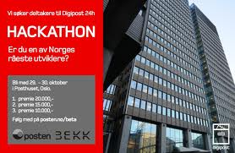
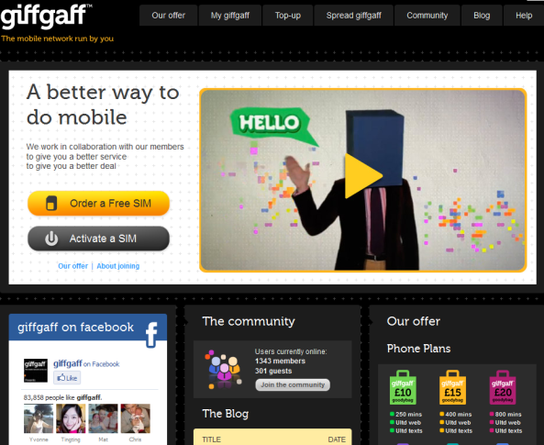
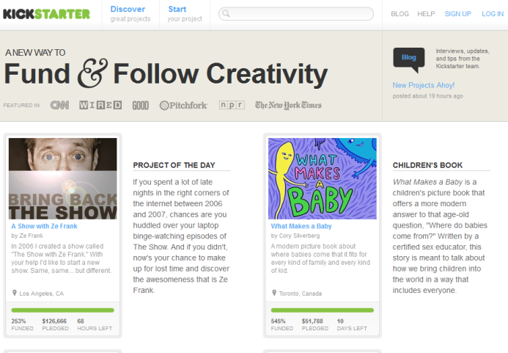
Applying the principles to services
Ability to co-create and real co-creation/contribution
Ensure that the participants/contributors have the required competence/abilities required to contribute and that their contributions are real

Slide 20
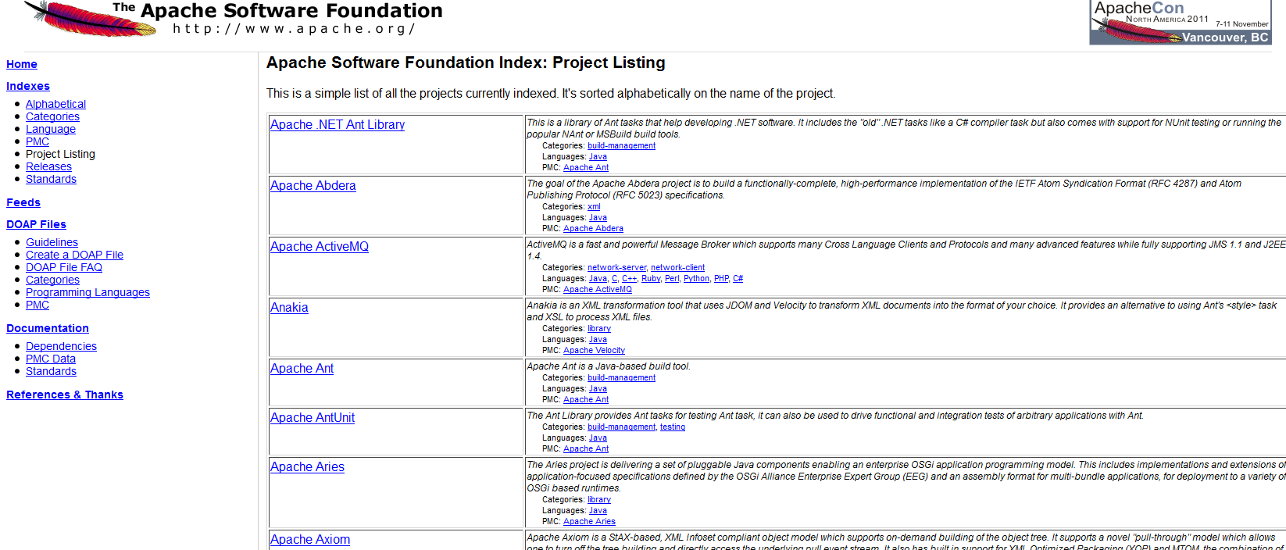
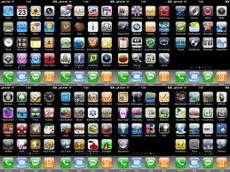
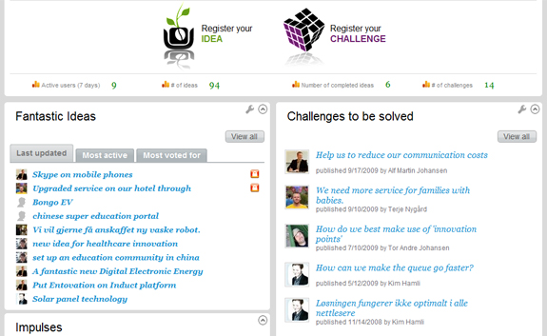
Applying the principles to services
Componentization / modularization
Make tasks/assignments/challenges that are manageable and separable that all contributors can identify with
Favorable characteristics for open source production are (a) its modularity (the overall project is divided into much smaller and well-defined tasks (`modules') that individuals can tackle independently from other tasks
(Lerner and Tirole, 2004)

Slide 21
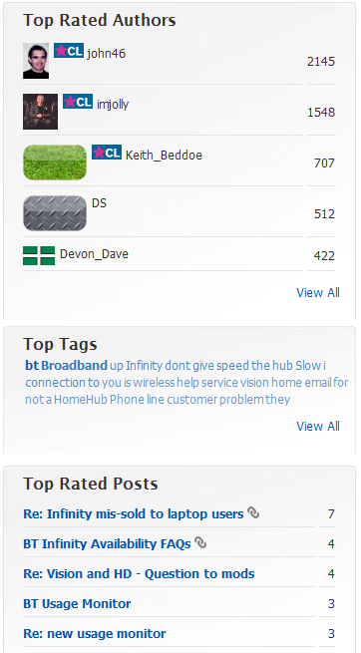
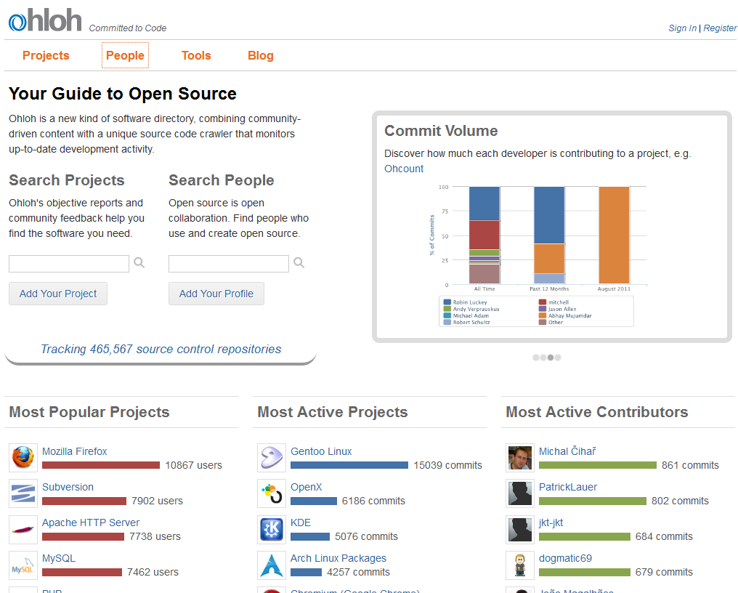
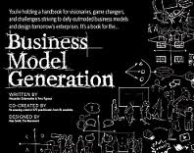
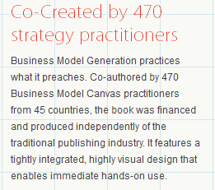
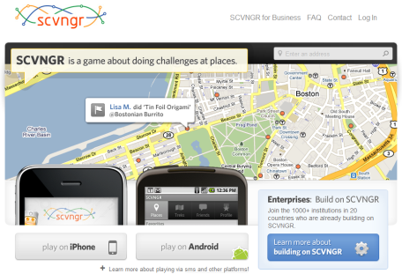
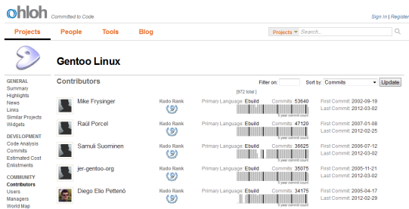
Applying the principles to services
Incentives to contribute and team building (social identity)
Use a multitude of incentive mechanisms, including gamification and offer social communities (identity)
Gamification
…from other tasks); and (b) the existence of fun challenges to pursue.
(Lerner and Tirole, 2004)

Slide 22
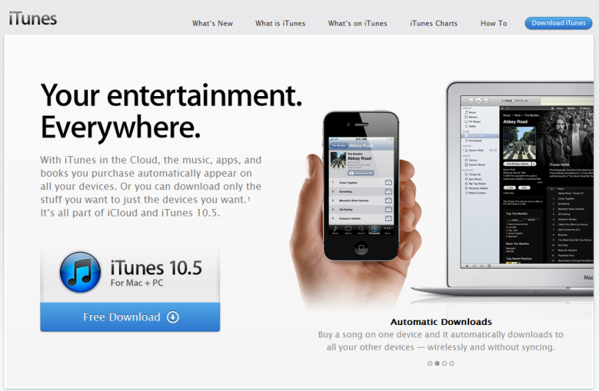
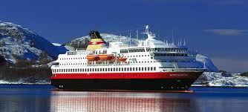
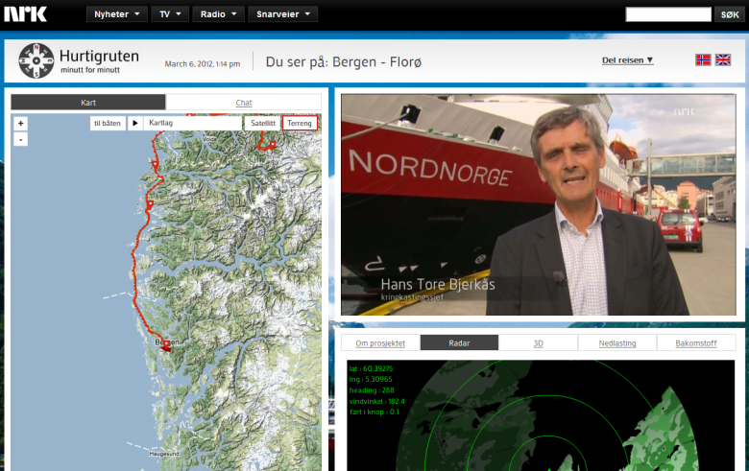
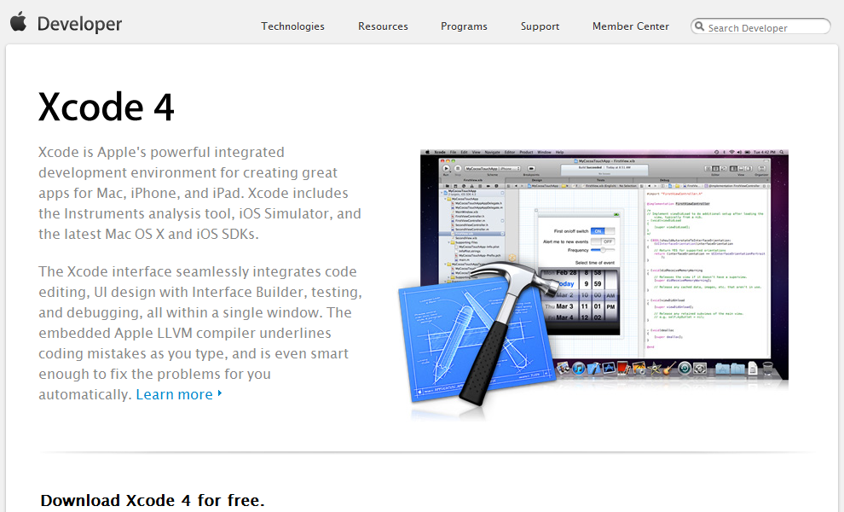
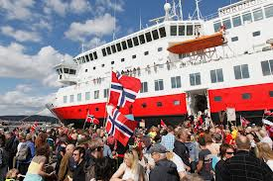
Applying the principles to services
Platform for co-creation and user toolkits
Offer a simple platform for co-creation and user toolkits

Slide 23
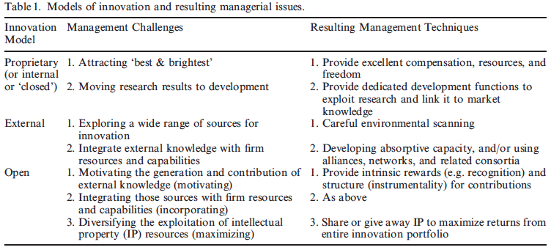
West and Gallagher, 2006
Conceptual paper with OSS empirical study, but rather untraditional reporting
Empirical material: 41 interviews of OSS innovation representatives, 800 news articles, community participation
No traditional transcription and analysis, reporting on projects/developments rather than informants
Management challenges addressed:

Slide 24
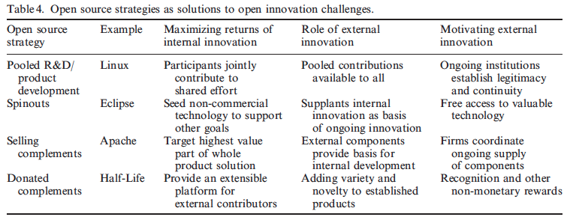
West and Gallagher, 2006
Focused challenges:
Ways to exploit internal innovation (maximization), incorporate external innovation into internal development (incorporation), and motivating outsiders (motivation)
Strategies:
Maximization – manage own IP portfolio, e.g. Selling complements (consulting), pooled R&D (trade IP)
Incorporation – planned pooled R&D, why – more gained from expanding market, few individual ways to commercialization
Motivation – multitude of incentive mechanisms, e.g. direct utility (share and apply), intrinsic benefits (learning), signalling (status, employment)
OSS has some particularities… transferable?

Slide 25
But what about customers – Oliveira and von Hippel (2011)
Oliveira and von Hippel, 2011 - Daniel

Slide 26
But what about customers – Oliveira and von Hippel (2011)
Empirical study, rather uncontroversial empirical data and method
Idea – List a number of currently offered commercial and retail banking services. Identify the locus of innovation for these services…
Theory:
General theory on service innovation as a producer centric process
General theory of user innovation
No match between these into propositions or hypotheses for services

Slide 27
But what about customers – Oliveira and von Hippel (2011)
Method:
List services of 5 largest commercial banks in US, both personal and corporate financial services
36 corporate (20) and retail (16) banking services, now computerized
Locus of innovation identified through financial trade journals to identify commercialized date
Searched through google scholar, books and other sources for the service idea publised prior to the commercialized date
Interviews and discussions with 14 finencial service experts
Findings:

Slide 28
But what about customers – Oliveira and von Hippel (2011)
Findings cont:
Same for manual services…
Implications:
Searching for innovations among users rather than co-development also relevant for services (source/idea) – lead user perspective also in services
Particularly important for self-service categories of services as users innovate on these as a ”platform”
Users adjacent activities to service offerings (e.g. data) is an important source of innovation (journey) that may create competitive advantage
Offer toolkits rather than predefined versions of services that users can innovate on

Slide 29
Summary
Open innovation
Open service innovation – challenges
Open service innovation – OSS
Open service innovation – user innovation

